Slide 1
Azure Migration-in-a-Box
SMB Partners Western Europe
Updated 9/6/2018
Anders Wendt, WE Azure PMM
JW Barkmeijer, WE OCP GTM

Slide 2
Azure Migration in a Box Partner Readiness Package
Partner Guidance
Partner Guidance
Who:
CSP Partners delivering migrations, with a primary focus on Western Europe customers in SMB CSP
MSFT field resource (PDM/PMA/TCM/BG) will also be accessing this information
This content is shareable, so please don’t hesitate to share with your channel and partners, and others who will find it helpful
Why:
Accelerate customer benefits moving to Microsoft Azure
Drive more growth business, faster
Spend less time searching for content; more time helping customers succeed
Leverage the best available materials from Microsoft
What to do:
Review the content and leverage across their demand generation campaigns and project work
Conduct joint account planning with MSFT counterparts

Slide 3
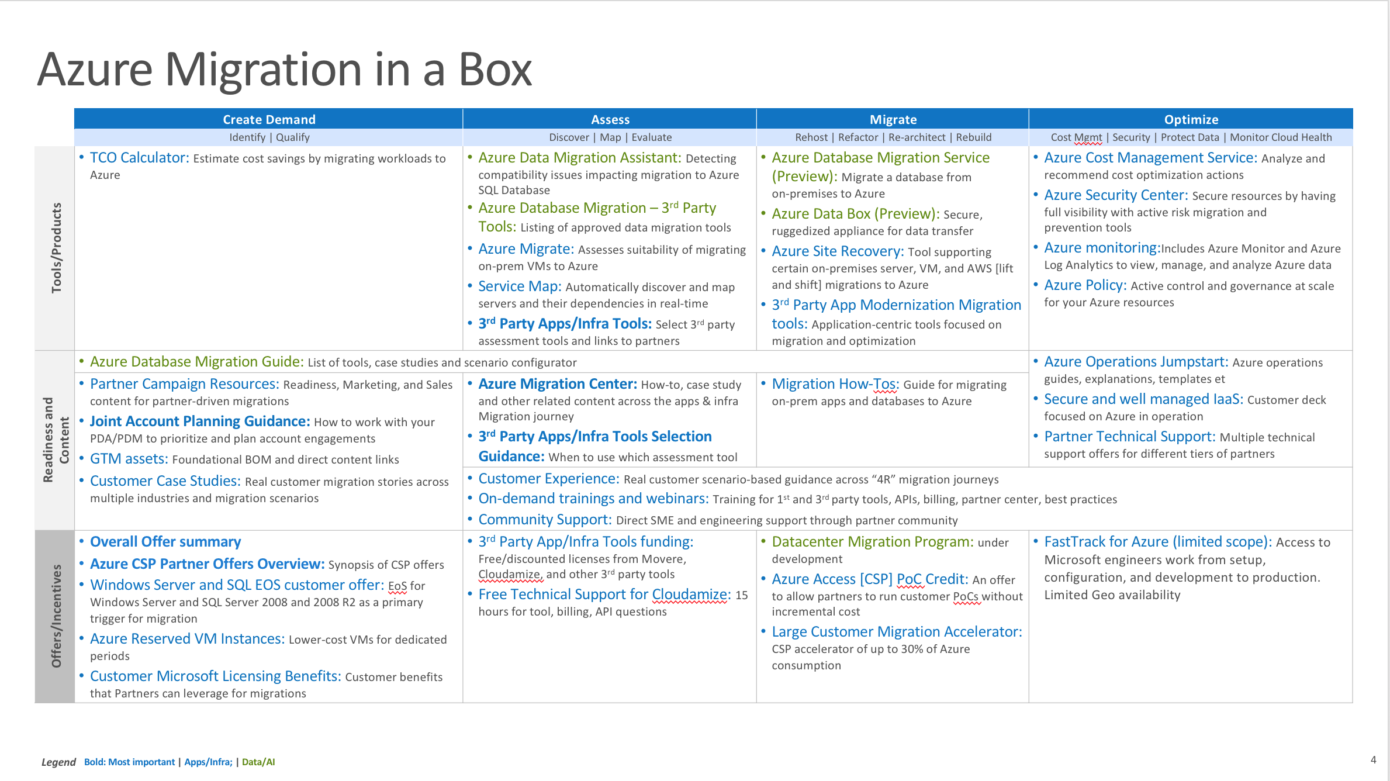
Azure Migration in a Box Partner Readiness Package
Context and Overview
Context
We’re now seeing a confluence of multiple triggers for TDMs and BDMs in SMB – including End of Support (EOS) cycles for Windows Server and SQL Server 2008 and 2008 R2, expiry of hosting/outsourcing contracts, software and hardware refresh, security threats, compliance commitments, need to quickly integrate acquired IP, urgent capacity needs to support expansion plans or the need to deliver applications faster based on business demand.
This represents an enormous opportunity for Microsoft and partners to move end customer workloads (infra + data) to Azure adding customers and next workload/s
Microsoft has an robust set of resources that can help partners be successful across the SMB customer migration journey
However, those materials are often not easily discovered by partners, as they are spread across many places (including internal-only locations)
Azure Migration in a Box Overview
A structured and curated set of the best deep dive content currently available to partners to help them migrate customer workloads to Azure
Covers tools, content and offers and incentives across the customer migration journey (Lead Gen, Assessment, Migration, Optimization)
Provides content summary, relevancy, and access information, to let partners “self-service” as much as possible
Will be updated through FY19. This particular deck is a customized version for SMB partners in Western Europe
Date: August 2018
WW Contact: azuremig@microsoft.com
WE Contact: andersw@microsoft.com

Slide 4
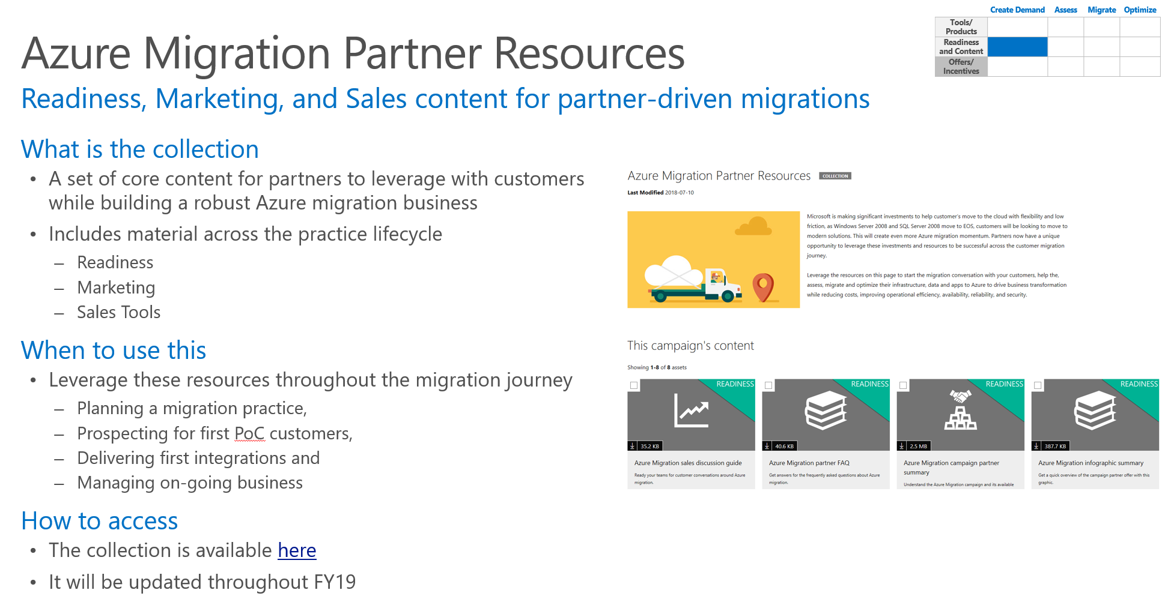
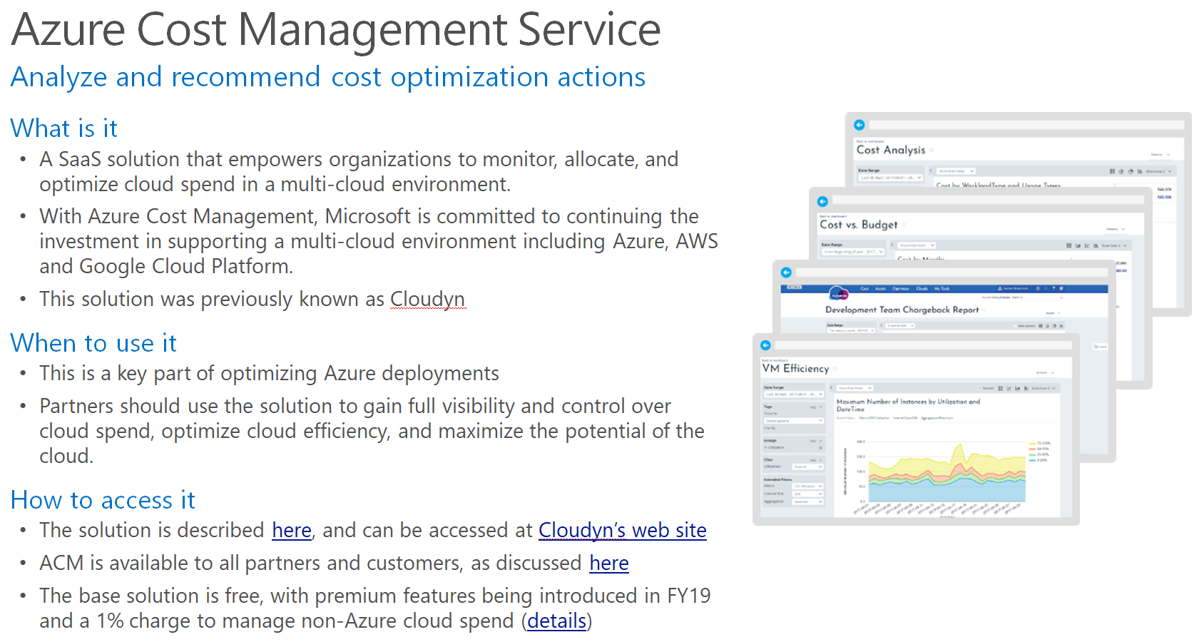
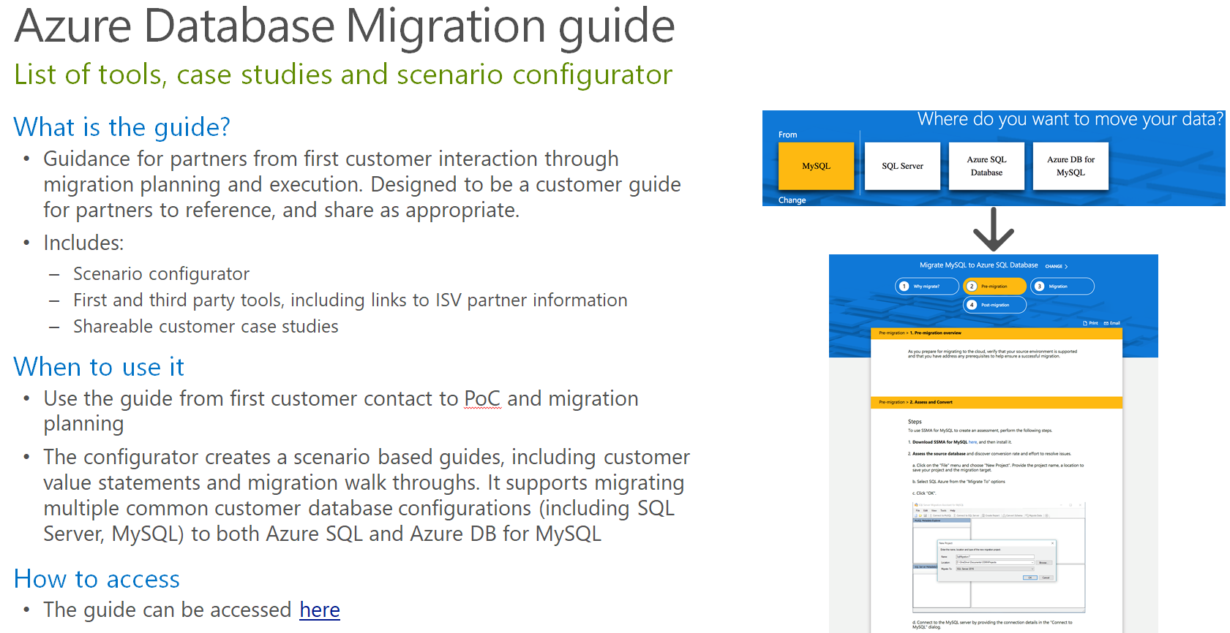
Example Double-Clicks:
What is it, how to use it, where to get it
Active Hyperlink to actual source material
(presentation, website, tool, etc.)

Slide 5
Start of Box
SMB Migration Partners in Western Europe

Slide 6

Content
1
Introduction
GTM Support
Offers
Appendix
“How to” Readiness Content
TCO and cost models
Migration tools
Technical Support
2
3
4

Slide 7
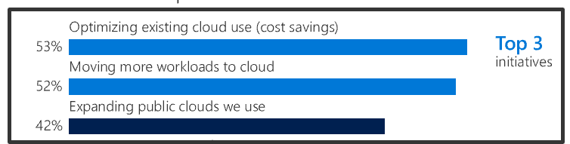
Azure Migration in SMB WE – Campaign Summary
 |  | IaaS is fastest growing subsegment, projected to grow 36.6% in 2017, 30.1% CAGR for next 5 years –Gartner and IDC
 |  | Key Sales Plays | Sales Programs
 |  | Hybrid & migration Migrate Windows and Linux infrastructure to Azure Migrate data estate to Azure App-led Create intelligent apps using Azure Additional plays Accelerate the usage through BCDR solutions Execute renewals or migration to Azure | Accelerate Azure penetration through the migration of on premises servers to Azure Windows Server & SQL Server EOS Investments Microsoft and partner offers SureStep dedicated HC Cloud Champion reseller enablement/activation
Microsoft offers
Market Insights
Core Value Proposoition
Azure Hybrid benefit for WS + SQL Server
Azure Reserved Instances + Consumption Incentive
Server subscriptions in CSP (single billing)
Azure migration free support (WS/SQL EOS)
Azure new customer Channel incentives accelerator
Free Budget & Time from Maintenance
Security & Compliance
Innovation
Partner offers
ISV migration offers 16 offers available
Cloudamize Migration assessment 50% off
CSP Incentives ACR and Customer Add
Marketing Support for CSPs (local) ACR and Customer Add

Slide 8

What’s driving customers to migrate to Azure?
Triggers
Datacenter lease
renewal, capacity crisis (!)
Hardware/
software refresh
Getting solutions to market
faster, being competitive
Value
Economics
(e.g., CAPEX to OPEX)
Security and Compliance
Innovation/Agility
Enablers
Workload and
process guidance
Migration tools
Ecosystem, programs,
and offers
Azure Migrate Campaign Framework

Slide 9

Migration realities
What’s getting in the way?
Accurate cost analysis of cloud versus on-premises
It’s too complicated—where even to begin? Customers need the “how to”…
Keeping the business running without downtime
Notes:
Migration to the cloud should be a well-planned journey, with well-defined milestones along the way. Without a strong plan, risks can include a complex and time-consuming process compounded by a lack of relevant skills, loss of control by moving computer resources off-premises, concerns about bandwidth, and unexpected costs. Microsoft has partners and a well-defined migration process, along with software tools, to ease this risk.

Slide 10
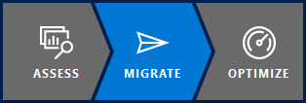
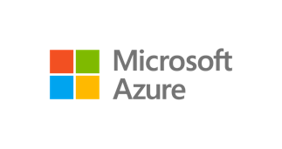
“The How” –
Simplified Azure migration experience
Do it yourself
Azure TCO calculator | Azure migration center | Azure Essentials
Azure Migrate: Unified, Extensible experience
Assess
Migrate
Optimize
Server Assessment Service
Server Migration Service
Database Migration Service
Storage Migration Service
Data Box
Security and Management
On-premises
Azure
ISV integration | Migration progress tracking
Assisted
FastTrack for Azure | Managed Service Providers | Systems integrators
Notes:
Talking points
Land vision
Migration is a journey. <Click> There is point A (i.e., on-premises source) and point B (i.e., Azure destination). Workloads – i.e., applications, databases, data, servers – needs to move from A to B.
We are making key investments to help customers be successful with the move:
<Click> Repeatable process & tooling to added workload specific as well as wholesale datacenter migration. Provide specific examples – e.g., we have tools to assess and move servers, tools to migrate data at
large scale, tools to migrate databases at scale etc. And we’re agnostic to 1st party vs. 3rd party tools. Our goal is to get customers to Azure.
<Click> DIY resources to help customers build their business case, have the right scenario guidance, and build the right cloud skills: TCO analysis, Azure migration center, Azure Essentials training
<Click> Assist models: Customer success programs like FastTrack/JumpStart along with a rich migration partner ecosystem

Slide 11

Cloud Migration – Core Value Prop
Free Budget & Time from Maintenance
80%
global IT budgets dedicated to maintenance

With the cost of mechanical and electrical equipment, ​as well as the price of power, this model no longer works..
Gartner, Press release: Gartner identifies 10 key actions to reduce IT infrastructure and operations costs by as much as 25 percent.
28%
time spent on administrative tasks
$$$$
Security & Compliance
Customers must mitigate security & compliance risk from WS/SQL 2008 EOS
Migration to Azure also offers added security and monitoring capabilities
Innovation
Customers want to do more than just cost-optimization they need agility to scale
Customers want to leverage the Intelligent Cloud stay competitive by differentiating themselves through new capabilities – Digital Transformation
Notes:
2018 will be a big year for cloud migration. This is a secular trend.

Slide 12





Customer Case Studies
 | Create Demand | Assess | Migrate | Optimize
Tools/ Products
Readiness and Content
Offers/ Incentives
Real customer migration stories across multiple industries and migration scenarios
What are the case studies
  Industry and scenario segmented customer case studies, for Azure Migration, new Azure applications and Digital Transformation stories
What’s the best way to use them
  Case studies can be help in the sales process to give customers a sense of the journey to Azure that others have taken
  Leverage these as part of sales pitches, using customer stories from similar industries where possible
How to access
  Link to Case studies
  Additional migration specific case studies will be posted in the Migration Center as they become available
SAMPLE CASE STUDIES
Customer | Industry | Summary
 | Travel and Transportation | Global transport and logistics company goes digital to transform its operations
 | Partner Professional Services | Delving into Wipro’s Cloud Journey with Microsoft Azure
 | Insurance | GEICO turbocharges insurance innovation in the cloud
 | Travel and Transportation | The fast lane to digital disruption: J.B. Hunt builds load-matching cloud service for shippers and carriers
 | Retail | Top online retailer bets on Azure to provide a stellar experience for 15.4 million customers worldwide

Slide 13

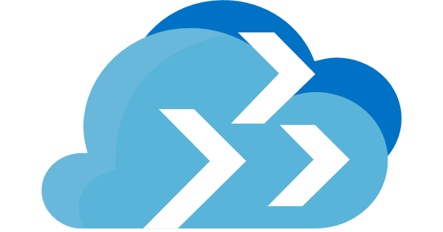



Key CTA: Drive assessments !
Use Azure Migrate when customer needs…
Use ISV tools when customer needs…
Assessment of heterogeneous environments
(physical, VMware and Hyper-V)
A Microsoft Azure branded tool which is free – repackaging of Azure Site Recovery
Assessment of VMware environments – Private Preview for Hyper-V & physical underway
Agentless dependency visualization
Cloud economics cost modelling
(including storage/networking costs)
Assessments of brand new Azure platform functionality
*) More tools are available in following sections….
Resources:
Migration Assessment Tool Overview ; Project Atlas – Assessment & Discovery Tool Matrix ; App Service Migration Tool ; See azure.com/migration/partners for full list
Notes:
JW/TK

Slide 14
Summary of “Box” Content
BOLD = Most Important
 | Create Demand | Assess | Migrate | Optimize
 | Identify | Qualify | Discover | Map | Evaluate | Rehost | Refactor | Re-architect | Rebuild | Cost Mgmt | Security | Protect Data | Monitor Cloud Health
Tools/Products | TCO Calculator: Estimate cost savings by migrating workloads to Azure | Azure Database Migration Assistant: Detecting compatibility issues impacting migration to Azure SQL Database Azure Database Migration – 3rd Party Tools: Listing of approved data migration tools Azure Migrate: Assesses suitability of migrating on-prem VMs to Azure 3rd Party Tools | Azure Database Migration Service (Preview): Migrate a database from on-premises to Azure Azure Data Box (Preview): Secure, ruggedized appliance for data transfer Azure Site Recovery: Tool supporting certain on-premises server, VM, and AWS [lift and shift] migrations to Azure 3rd Party App Modernization Migration tools: Application-centric tools focused on migration and optimization | Azure Cost Management Service: Analyze and recommend cost optimization actions Azure Security Center: Secure resources by having full visibility with active risk migration and prevention tools Azure monitoring:Includes Azure Monitor and Azure Log Analytics to view, manage, and analyze Azure data Azure Policy: Active control and governance at scale for your Azure resources
Readiness and Content | Azure Database Migration Guide: List of tools, case studies and scenario configurator Cloud Migration playbook: Playbook to help new and existing Microsoft partners accelerate or optimize your Azure-focused practice by teaching you the ins-and-outs of migrating workloads or modernizing applications and hosting them in Microsoft Azure. |  |  | Azure Operations Jumpstart: Azure operations guides, explanations, templates et Secure and well managed IaaS: Customer deck focused on Azure in operation Partner Technical Support: Multiple technical support offers for different tiers of partners
 | Partner Migration Resources: Readiness, Marketing, and Sales content for partner-driven migrations GTM assets: Foundational BOM Customer Case Studies: Real customer migration stories across multiple industries and migration scenarios | Azure Migration Center: How-to, case study and other related content across the apps & infra Migration journey | Migration How-Tos: Guide for migrating on-prem apps and databases to Azure
 |  | Customer Experience: Real customer scenario-based guidance across “4R” migration journeys On-demand trainings and webinars: Training for migration scenarios, 1st and 3rd party tools, APIs, billing, partner center, best practices Community Support: Direct SME and engineering support through partner community
Offers/Incentives | FY 19 Partner Offers Azure CSP Partner Offers Overview: Synopsis of CSP offers including CSP incentives Windows Server and SQL EOS customer offer: EoS for Windows Server and SQL Server 2008 and 2008 R2 as a primary trigger for migration. This includes extended support for security updates when running on Azure. Azure Reserved VM Instances: Lower-cost VMs for dedicated periods Customer Microsoft Licensing Benefits: Customer benefits that Partners can leverage for migrations | 3rd Party App/Infra Tools funding for CSP: Discounted licenses from Cloudamize and other 3rd party tools Free Technical Support (CSP only): 15 hours for tool, billing, API questions | Azure Access [CSP] PoC Credit: An offer to allow partners to run customer PoCs without incremental cost Large Customer Migration Accelerator: CSP accelerator of up to 30% of Azure consumption | FastTrack for Azure (limited scope): Access to Microsoft engineers work from setup, configuration, and development to production. Please note that FastTrack has a limited language support and requires a target of 5 000 USD Azure / month consumption.
Notes:
Process/source- Arnold Group discussions with internal SMEs and (upcoming) partners used to confirm
Prioritization
Content quality / completeness

Slide 15


FY19 GTM SMB & Central Marketing Support
WE Together

Slide 16
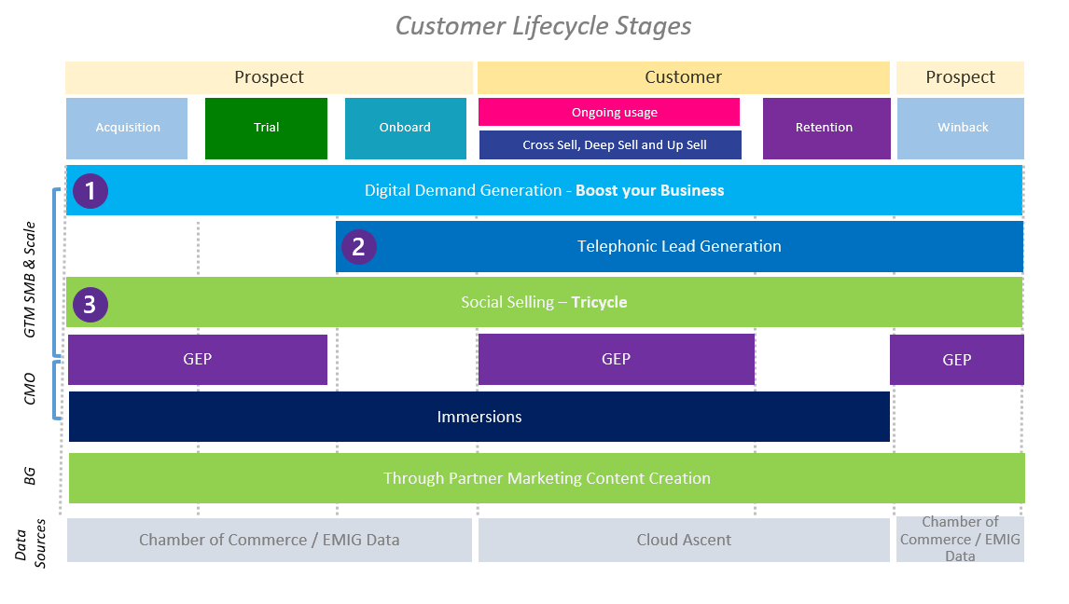
FY19 Central Thru Partner Marketing Overview
  Overview
Based on feedback from partners and internal learnings we have build 3 new Go to Market engines:
  We will work have the same way of working across Western Europe
  We will work with local agencies to ensure local language and market insights are covered
We will team with Microsoft Product teams to create content partners can use through Central engines or themselves
  Tools/Discoverability
  Benefits
SMB & Central Marketing Program Team Desk: wegtmcm@microsoft.com
Sway with all programs and updates: aka.ms/WEGTMPrograms
Gear Up Weekly Webinar Series will update partners on Product updates (3x) and Marketing (1x) a month
GTM SMB & Central Marketing team will build communities with local TPM agencies enabling partners to work cross borders
Standardized processes and tooling across all WE subs

Slide 17
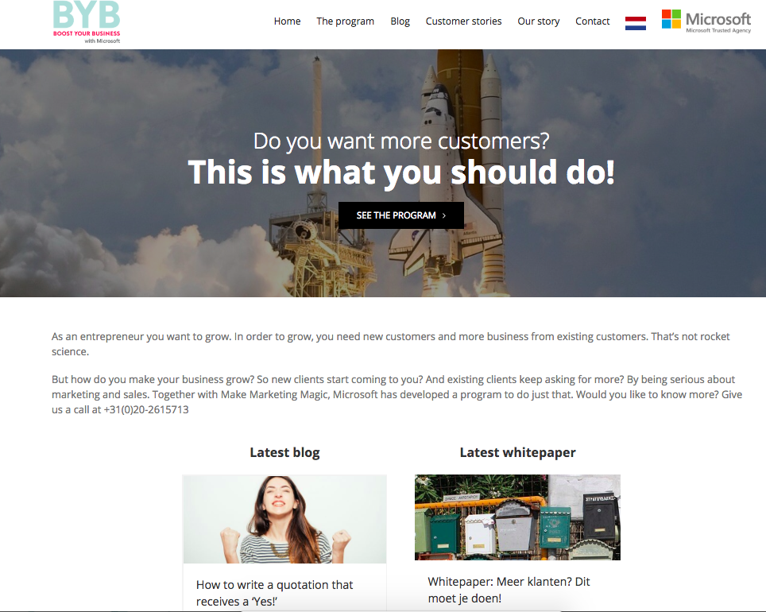
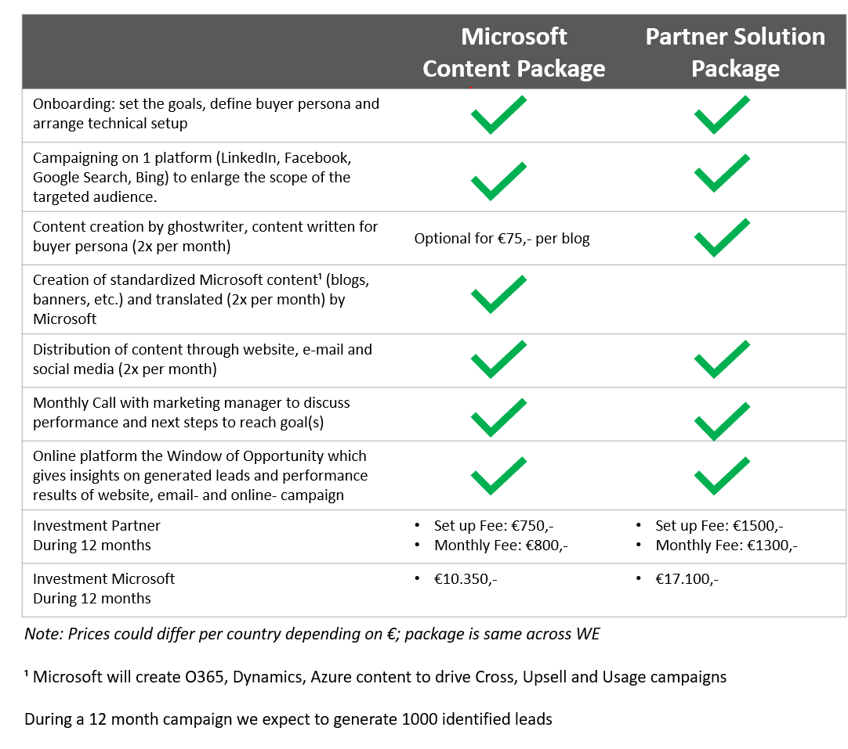
Digital Demand Generation | Boost your Business
  Overview
  Program Set Up
Boost your Business is a digital demand generation program which will run for 12 months.
During the program we will help partners build the relevant content for their target audience and buying persona
Boost your Business will use Chamber of Commerce data giving partners ability to target specific industries and segments
YourWOO, a tool which will analyse and report the partners digital presence, can be used by all partners.
  Tools/Discoverability
  Benefits
YourWOO will enable partners to report back on Marketing and Sales qualified leads
We will analyse and the partners own digital presence (website, social) free of charge and report findings and up to 20 MAQL’s for free
GDPR compliant
Ability for partners to use the Chamber of Commerce data without additional investments

Slide 18
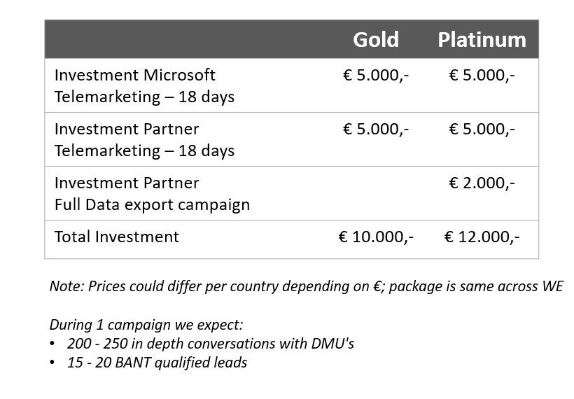
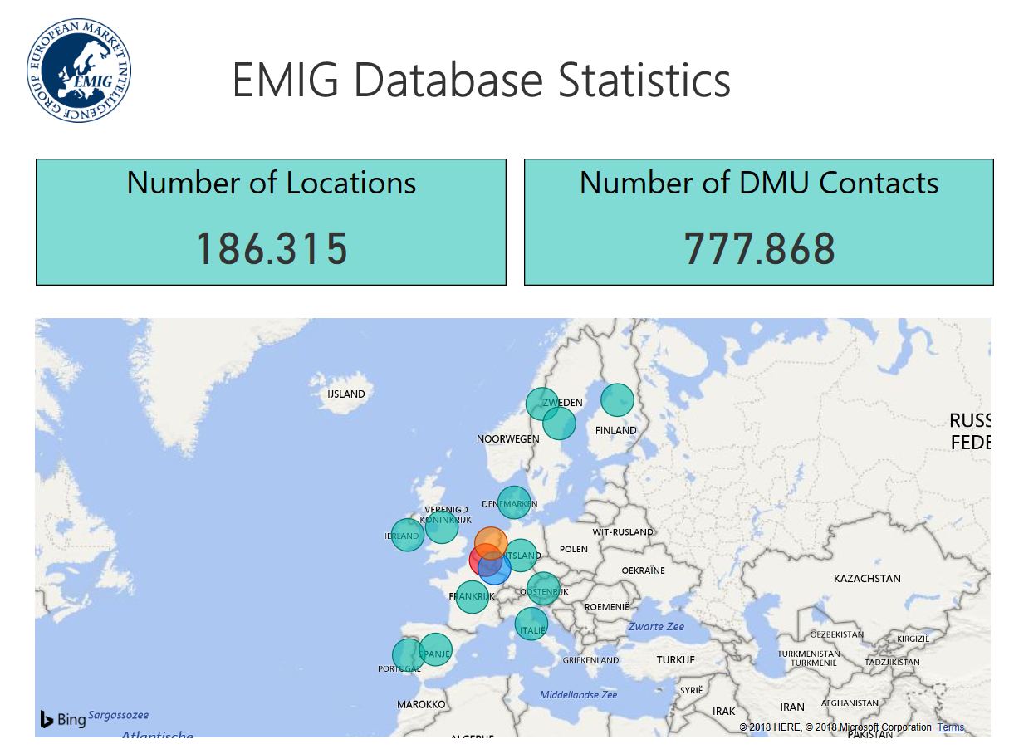
Telephonic Lead Generation | Computer Profile
  Overview
  Program Set up
Telephonic Lead Generation with Computer Profile gives partner the option to generate TQL’s with local agencies.
The EMIG database provides insights in adressable market.
Partners have the ability to share their own data for the campaign; data will not be shared with Microsoft or used for other partners.
  Tools/Discoverability
  Benefits
EMIG Database which meets all GDPR requirements
Leads are shared on a daily basis with partners and, if partner has access to Partner Sales Connect leads will be shared in bulk upload template
Partners have the option to receive all data gathered during campaign (€2k investment)
GDPR compliant
Partners don’t need to invest in data and worry about GDPR
Agencies selected have skilled Business Development Specialists who will have regular training sessions with Microsoft on Products
Option to send an email to one of the 366k DMU’s in Western Europe

Slide 19
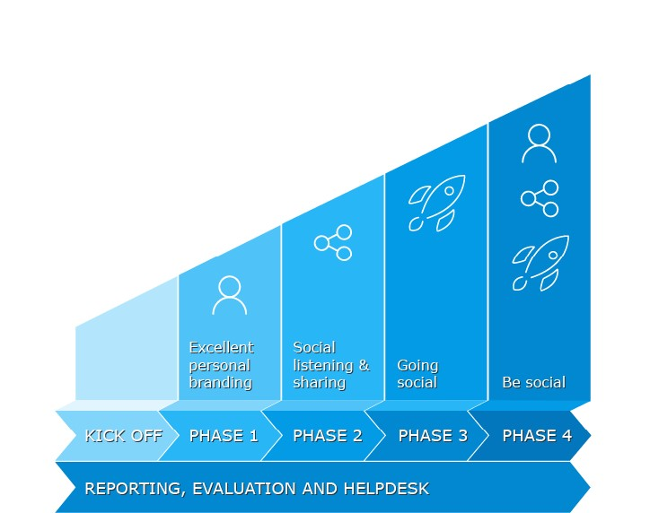
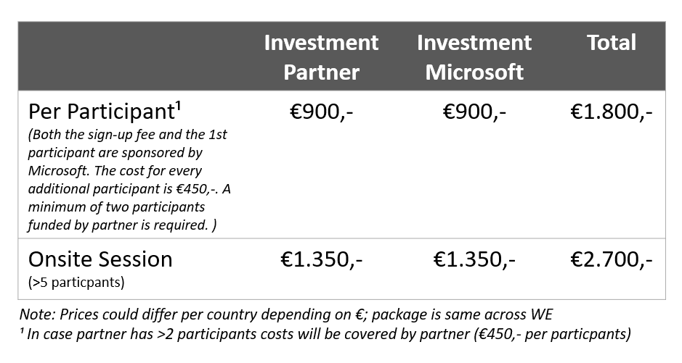
Social Selling | Trycicle
  Overview
  Program Set up
GTM SMB & Scale Social Selling Program unlocks the ability for WE partners to co-invest in Social Selling capabilities within partners Sell and Marketing organisation
Tricycle will report on progress throughout the program (participants level) on SSI score, # of new contacts, # content shared
  Tools/Discoverability
  Benefits
Tricycle Program which offers 1:1 sessions or partner sessions through webinars
LinkedIn Sales Navigator (option to use 30 day trial version)
Tricycle will cover Referrals and help partners to set up / optimise the partner profile page.
Tricycle will enable us to roll out Social Selling at scale within WE and help partners optimise ABM
Social Selling will increase dealsize 1.2x’and revenu 1.5x
2.4x more opportunities for sellers with Social Selling Index (SSI) > 70 compared to sellers with SSI of <40

Slide 20
Partner and Customer Offers SMB Migration Partners in Western Europe

Slide 21
FY19 Azure Partner Offers – SMB Western Europe
 | Create Demand | Assess | Migrate | Optimize
Tools/ Products
Readiness and Content
Offers/ Incentives
Lead Gen
Assessment
Migration
Optimization
 | Summary | Access?
Customer benefits partners can use | Windows Server and SQL EOS offer: Migrate Windows Server and SQL Server 2008 and 2008 R2 from on-premises to Azure VMs with no application code changes and get three more years of security updates after EOS at no additional cost. Only in Azure. Upgrade when ready | See content in this Box | ● |  |  | ●
 | Azure Reserved VM Instances: Customers save money by pre-paying for one-year or three-years of continuous compute capacity. Azure RI can significantly reduce virtual machine costs – up to 72 percent on pay-as-you-go prices–with one-year or three-year upfront commitment | See content in this Box | ● |  |  | ●
 | Azure Hybrid Benefit: Customers with Software Assurance can use their On-premises Windows Server Licenses to run Windows virtual machines on Azure at up to 49% reduced cost and SQL Server Licenses to run Azure SQL database at an up to 30% reduced cost | See content in this Box | ● |  |  | ●
CSP offers | Azure Access CSP POC: Free proof-of-concept credit for qualified Azure opportunities in CSP. 10% of the deal size in 12 months | See content in this Box |  | ●
 | 3rd Party App/Infra Tools funding : Allows partners to more efficiently and economically access Assessment and Migration tools | See content in this Box |  | ●
 | Free Technical Support for CSP: Support and training for APIs, billing, partner center, migration best practices | See content in this Box |  | ●
Large Customer Deals | Intelligent Cloud Infra/Data ECIF Funding investment in our customer by utilizing Partner and Microsoft Consulting Services (MCS) to help customers drive net new revenue and consumption. Requirements: Recommended 10x ROI; Must drive new Azure Consumed Revenue or new SQL revenue on-premise scenarios & Azure Data Services on consumed revenue. | Check with your local Microsoft contact | ● | ● | ● | ●
 | Large Customer Migration Accelerator: Partners can earn up to 30% of the Azure deal size in rebate from Microsoft based on their consumption performance throughout the migration process. Requirement: Partners must be providing managed services on top of the migration to Azure to qualify | Check with your local Microsoft contact |  |  | ●
 | FastTrack for Azure Production deployment services of strategic Azure solutions (Azure 10) for end customers to drive Azure Consumed Revenue and Azure Customer Adds. | Check with your local Microsoft contact |  |  | ● | ●
Partner incentives | CSP Incentives: |  |  |  | ● | ●
Additional offers may be available at the local area - check with your local PDM/PMA resources.

Slide 22

Windows Server and SQL Server customer offer
 | Create Demand | Assess | Migrate | Optimize
Tools/ Products
Readiness and Content
Offers/ Incentives
End of Support for Windows Server and SQL Server 2008 and 2008 R2 as a primary trigger for migration
What is the offer
  A new EOS customer offer for Windows Server and SQL Server 2008/R2 customers
  The combination of Extended Support Updates + Azure Hybrid Benefit is the right offer at the right time
  Migrate Windows Server and SQL Server 2008 / 2008 R2 to Azure VMs with no application code changes and get three more years of security updates after EOS at no additional cost. Only in Azure.
  While SQL Server on Azure IaaS is an option, migration to Azure SQL Database Managed Instance is our leading guidance, for a managed, version-free experience
How to use it
  Together with other compelling reasons to migrate, this offer represents a tremendous opportunity and motivation for customers to make the shift to Azure
  Market data shows that customers have been holding off on server investments as they decide on cloud plans, and this has created pent-up demand for refresh or rehost decisions
How to access
  Windows Server on Azure
  Windows Server 2008/R2 EOS
  SQL Server 2008/R2 EOS
  FAQ
Options to manage end of support for 2008 and R2 workloads
Cost effective
Transform with Azure
OR
Upgrade on-premises
Migrate applications to Azure VMs
Get 3 years of Extended Security Updates for Windows Server 2008 and 2008 RQ at no additional charge
Upgrade to latest version
Windows Server 2016 or 2019
SQL Server 2017 or 2016
Migrate data to Azure Managed Instances or VMs
Azure Managed offers a version free option
Azure virtual machine include 2 more years of Extended Security Updates for SQL Server 2008 or 2008 R2 at no
additional charge
Or buy time to upgrade
Buy extended Security Updates to get 3 more years of security updates for windows Server and SQL Server 2008 or 2008 R2
Upgrade when ready
Modernize when ready
Upgrade in Azure when ready
Or transform apps and data with
Azure services
Key dates:
July 9, 2019 – End of Support for SQL Server 2008 and 2008 R2
January 14, 2020 – End of Support for Windows Server 2008 and 2008 R2

Slide 23
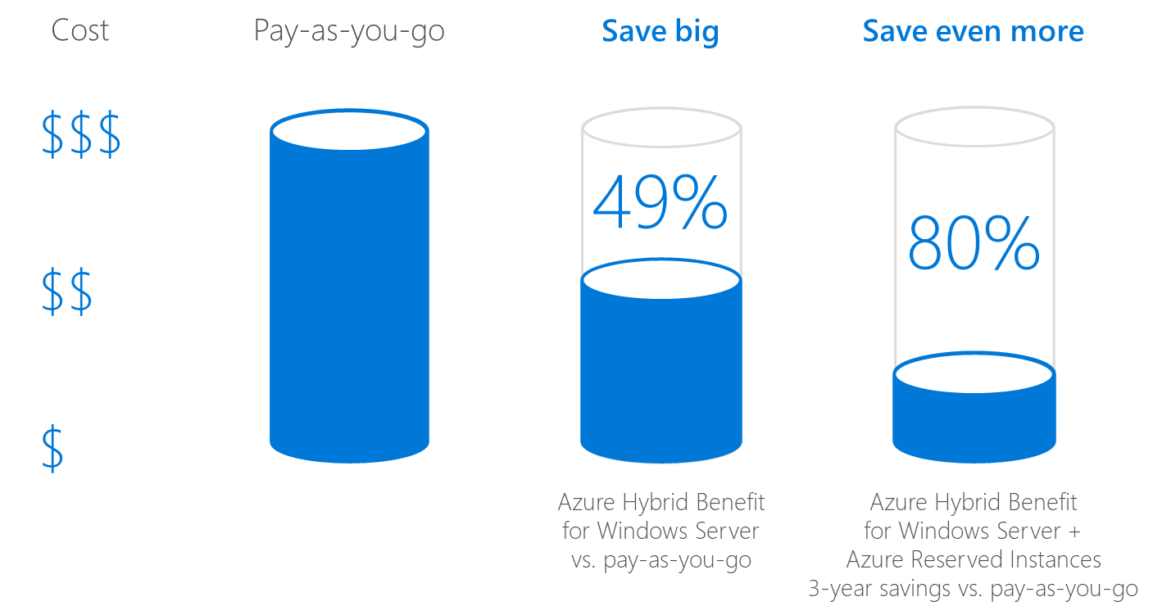
Azure Hybrid Benefits and Reserved VM Instances
 | Create Demand | Assess | Migrate | Optimize
Tools/ Products
Readiness and Content
Offers/ Incentives
Lower-cost VMs for dedicated periods
What are Azure Reserved Instance (RI) VMs
  Allows customers to save money by pre-paying for one-year or three-years of continuous compute capacity
  Up to 73% saving with the combination of Azure Hybrid Benefit for Windows Server and 3-year Azure Reserved Instance
  Reserved Instances provide a billing discount and do not affect the runtime state of virtual machines
When customers should use RI
  If customers have virtual machines that run for long periods of time, purchasing a Azure RI is likely the most cost-effective option
  Customers can save even more if this is combined with
  Azure Hybrid Benefit Overview on next slide.
How to access
  Introduction to RI
  Purchase link (Azure subscription required)
  Program details

Slide 24
Azure Hybrid Benefit
 | Create Demand | Assess | Migrate | Optimize
Tools/ Products
Readiness and Content
Offers/ Incentives
Customer benefit that Partners can leverage for migrations
Azure Hybrid Benefit
Customers with Software Assurance can use their:
  On-premises Windows Server Licenses to run Windows virtual machines on Azure at up to 49% reduced cost
  SQL Server Licenses to run Azure SQL database at an up to 30% reduced cost or to run SQL Server in virtual machines
Allows customers to maximize their current investment in Software Assurance
Combined with Azure Reserved Instances customers can save up to 82% compared with on premises Windows Server costs
  Program description
Using AHB for Windows Server

Slide 25
Azure Access CSP PoC Credit
CSP
 | Create Demand | Assess | Migrate | Optimize
Tools/ Products
Readiness and Content
Offers/ Incentives
An offer to allow partners to run customer PoCs without incremental cost
What is it
  Azure credit to use in qualified customer situations to enable customers to migrate a representative sample dataset/element of infrastructure/app in a risk free way
  Because trial is a critical component of getting customers to see both the value of Azure, and also how easy it is to migrate, given the right partner and Microsoft support
When to use it
  For strategic partners who are working with customers above a minimum opportunity size of $30K USD per year. Partner can get up to 10% of the deal size in POC credit for 2 months. (1:10 ROI)
  Leverage this via a simple qualification process
How to access
  Work with your PDM

Slide 26
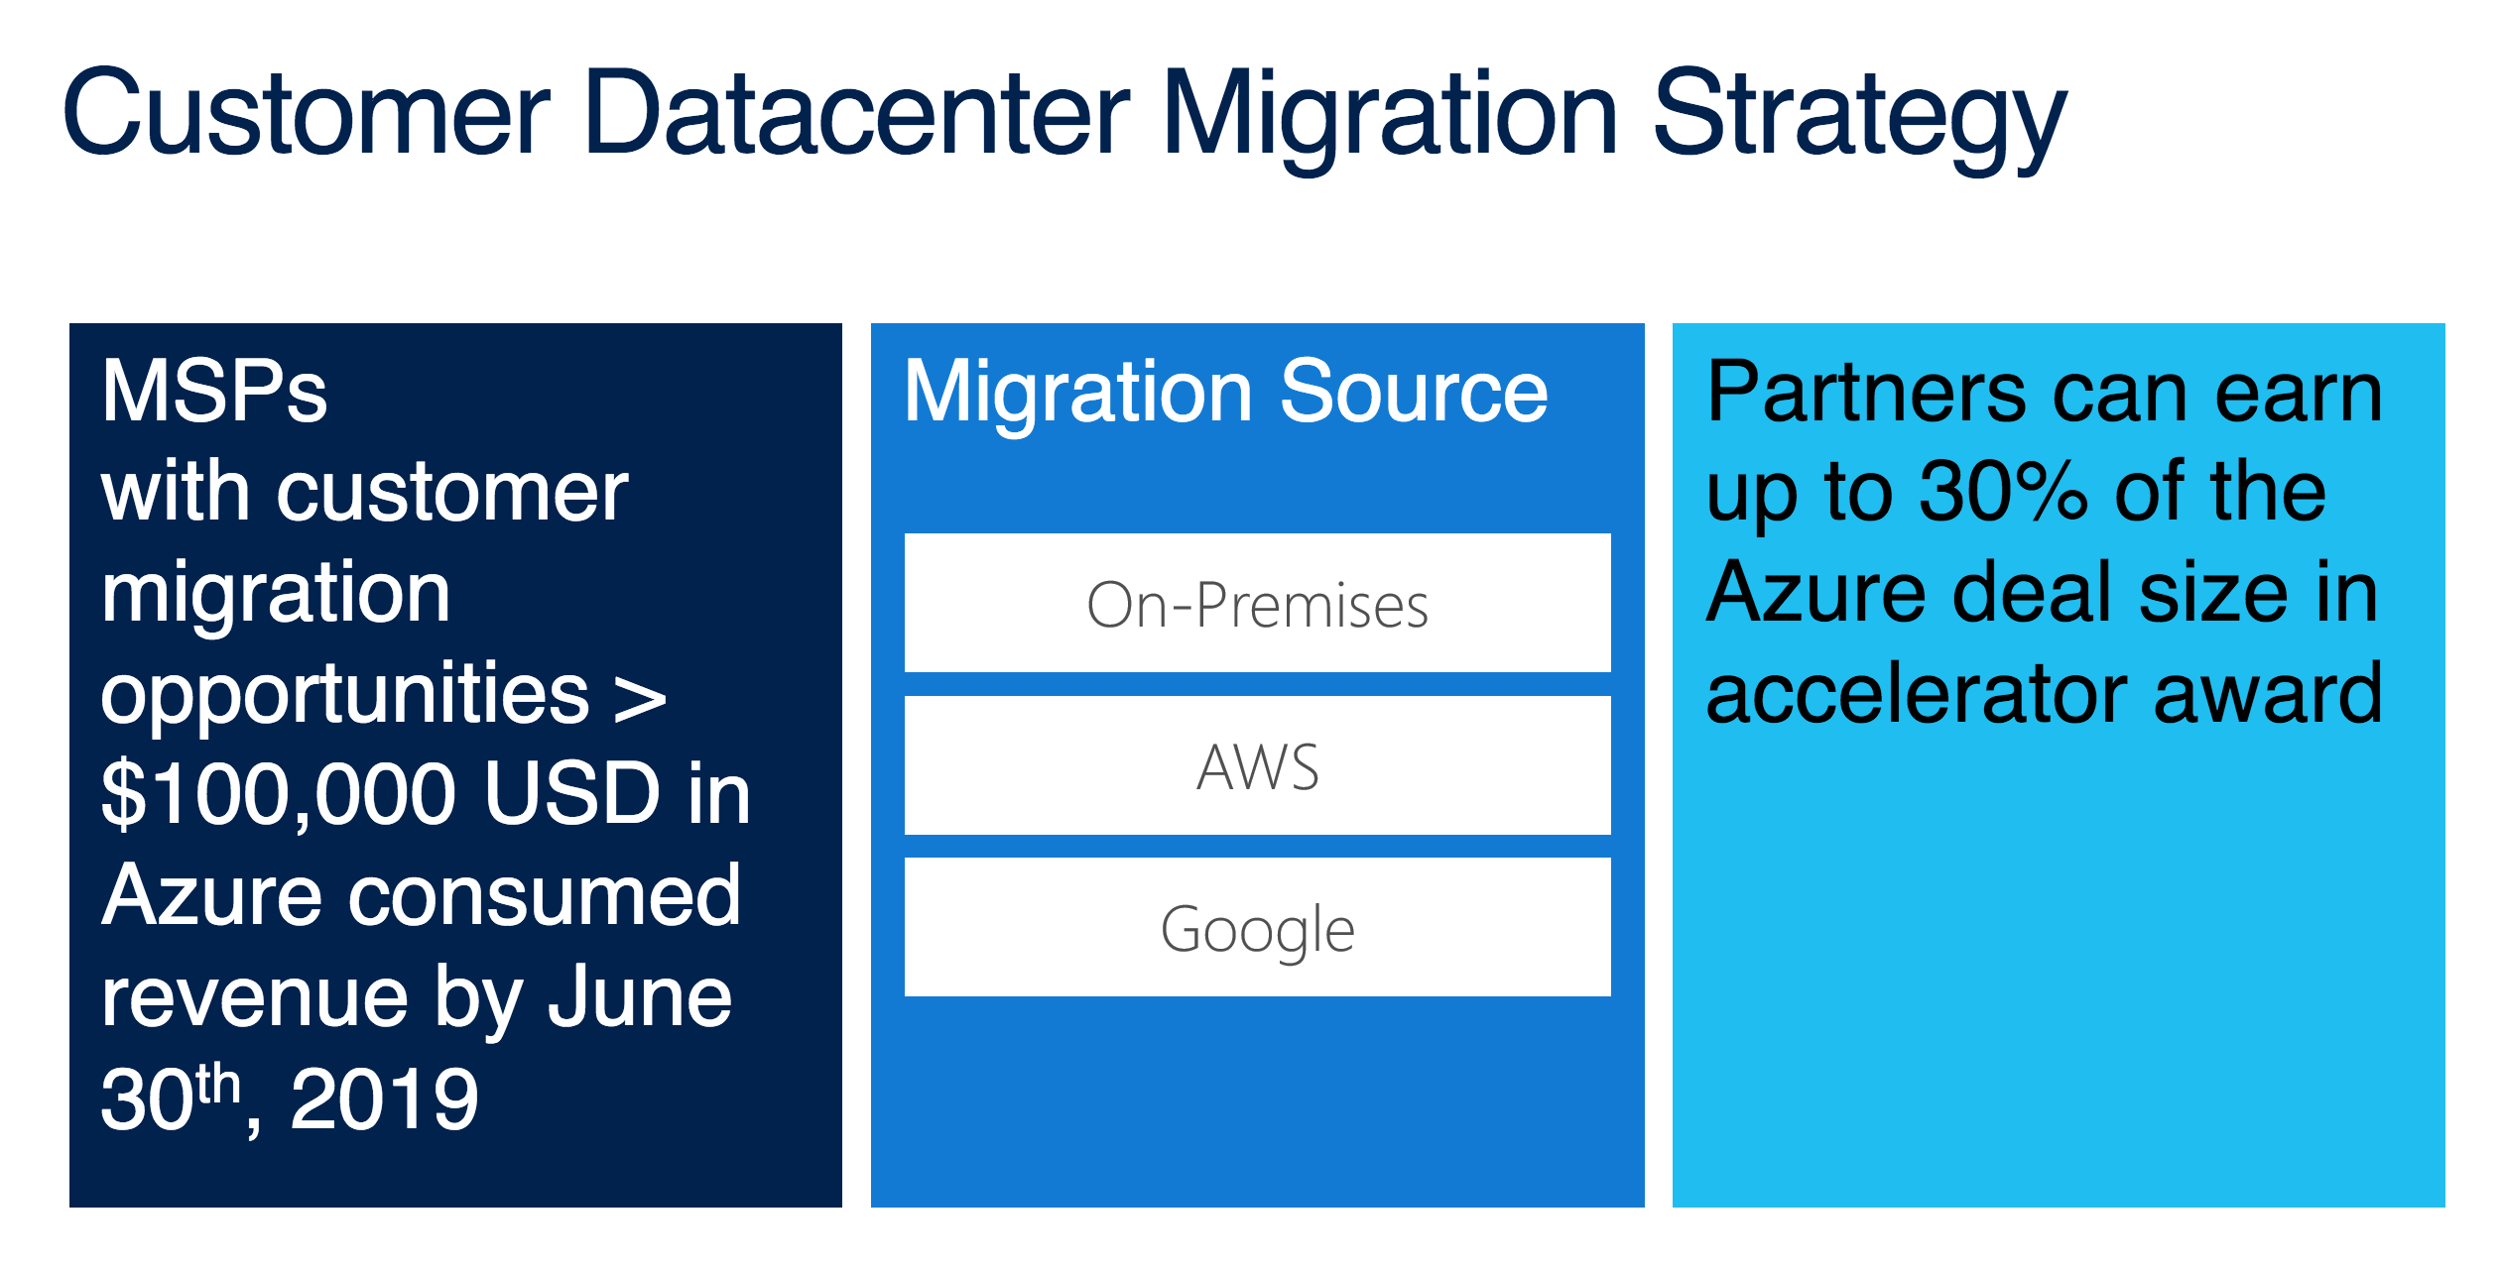
Large Customer Migration Accelerator
CSP
 | Create Demand | Assess | Migrate | Optimize
Tools/ Products
Readiness and Content
Offers/ Incentives
CSP accelerator of up to 30% of Azure consumption
What is it
  Large Customer Migration Accelerator is open for partners transacting Azure on CSP and providing Managed Migration Services.
  Partners can earn up to 30% of the Azure deal size in rebate from Microsoft based on their consumption performance throughout the migration process (capped at $1M USD per opportunity)
When to use it
  The Large Customer Migration Accelerator only consider consumed revenue
  Partners must be providing managed services on top of the migration to Azure to qualify
  Only deals already closed between customer and partner will be approved
  The Large Customer Migration Accelerator can be requested when the partner purchased RI for the customer, however the consumption per month will be lower due to the discount provided by the RI
How to access
  Contact your local PDMs for details on this program

Slide 27
Free Technical Support
CSP
 | Create Demand | Assess | Migrate | Optimize
Tools/ Products
Readiness and Content
Offers/ Incentives
15 hours for tool, billing, API questions
What is it
  Support and training for tooling, APIs, billing, partner center, migration best practices
  Microsoft has partnered with Sysgain Inc, a SI company based in Redmond and India, that specializes in migration and CSP consulting services to Managed Service Providers, on how to approach and succeed in datacenter migration.
When to use it
  For Customer Datacenter Migration Program partners receive up to 15 hours of CSP technical support provided by Sysgain free of charge. The support include:
    Provide migration guidance and support on tools, techniques, processes, provide necessary documentation
    Provide Guidance on CSP & any integration help as needed
How to access
  To access the Sysgain offer send the list of e-mail addresses that will interact with CSP technical helpdesk to customermigsupport@sysgain.com

Slide 28
FastTrack for Azure
 | Create Demand | Assess | Migrate | Optimize
Tools/ Products
Readiness and Content
Offers/ Incentives
Access to Microsoft engineers to drive Azure migration projects. Limited Geo availability
What it is
  Partners can work hand-in-hand with Azure engineers to migrate customers to Azure.
When to use it
  Currently available for eligible customers in US, Canada, UK, Western Europe, Australia and New Zealand (English only)
  For customers planning to spend more than $5,000 per month, on supported Azure solutions (see full eligibility requirements)
How to access
  Partners can nominate customers here (FastTrack for Partner resources)
  FastTrack for Azure customer eligibility
Solution Enablement | Collaborate with Azure engineers to align on plan and approach to successfully build and deploy Azure solutions and expedite your customers’ onboarding.
Technical Guidance | Better understand technical principles and practices with direct access to Azure engineers throughout the engagement.
Architecture design review | Build or verify optimal, scalable solutions in architectural design review sessions with Azure engineers
Engineering-led technical resources | Strengthen your awareness of all Azure solutions and FastTrack for Azure best practices to help your customers maximize the value of the cloud

Slide 29
End of Box

Slide 30
Appendix
Readiness Content
TCO and Cost Management
Apps & Infra Migration Tools
DB Migration tools
Partner Technical Support
On Demand Trainings and Webinars (WW, MS Corp)
  For reference. Please refer to Cloud Champion in Wester Europe
Additional tools:
Service Map

Slide 31
Readiness Content
SMB Migration Partners in Western Europe

Slide 32
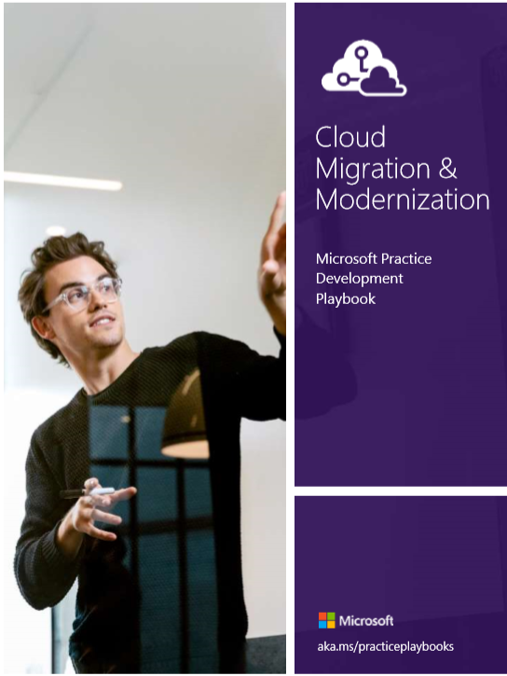
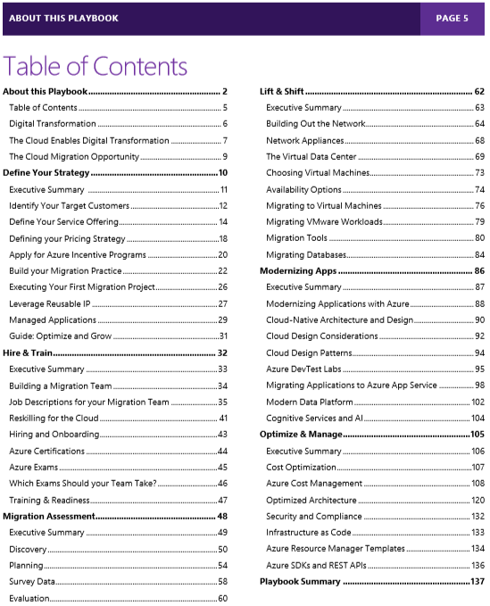
Cloud Migration Playbook
 | Create Demand | Assess | Migrate | Optimize
Tools/ Products
Readiness and Content
Offers/ Incentives
A guide on how to build, accelerate and optimize your Azure-focused migration practice
What is the guide
  Guidance for new and existing Microsoft partners on the ins-and-outs of migrating workloads or modernizing applications and hosting them in Microsoft Azure.
  Includes:
    Strategies to build a migration or modernization practice, including which workloads to focus on, how to price your services, and how to build your team
    Detail guidance on how to plan and execute the migration of an existing workload to Azure, tools, technical details on best practices
How to access
  The playbook can be accessed here

Slide 33
Customer Experience
 | Create Demand | Assess | Migrate | Optimize
Tools/ Products
Readiness and Content
Offers/ Incentives
Real customer scenario-based guidance across “5R” migration journeys
What is it
  Azure Migration Center has structured BDM and TDM guidance for multiple migration scenarios
  Covers basic lift-and-shift all the way to rebuilding apps, as well as initial assessment and optimization
When to use it
  During customer discussion and to select tools and methods for specific customer migrations
  The Migration Center also has rich content on post-migration optimization
How to access
  Azure Migration center
  (see also the case studies, for specific customer examples)
Key Migration stages covered by Migration Center content
Assess | Migrate |  |  |  | Optimize
 | Rehost | Refactor | Rearchitect | Rebuild
Discover- using cloud migration assessment tools, compile an inventory of the physical and virtual servers in your environment. Map servers to represent on-premises applications Evaluate how to best move each on-premises application | When to consider Free up datacenter capacity Apps that are in “maintain mode” Pros No re-architect or new code Least effort for quick migration Cons Doesn’t take full advantage of cloud Manual patching, upgrades No automated app scaling and high availability | When to consider Need a quick way to modernize Code portability is important Pros No re-architect or new code Increased density and lower deployment cost Improved productivity and DevOps agility Portability of apps and dependencies High availability with orchestrators Cons Containerization is an additional step | When to consider Monolithic, spaghetti code Pros Higher availability Greater agility Better modularity and reuse Optimized for pay-as-you-use features that save you money Cons Requires significant code refactoring | When to consider Applications that are key to future business success Pros Optimized for long-term agility Optimized for scale and high availability Optimized for pay-as-you-use features that save you money Cons Requires significant core rewrite (or new code) | Manage costs to invest with confidence Enable Industry leading security Monitor cloud health Protect your data in the cloud

Slide 34
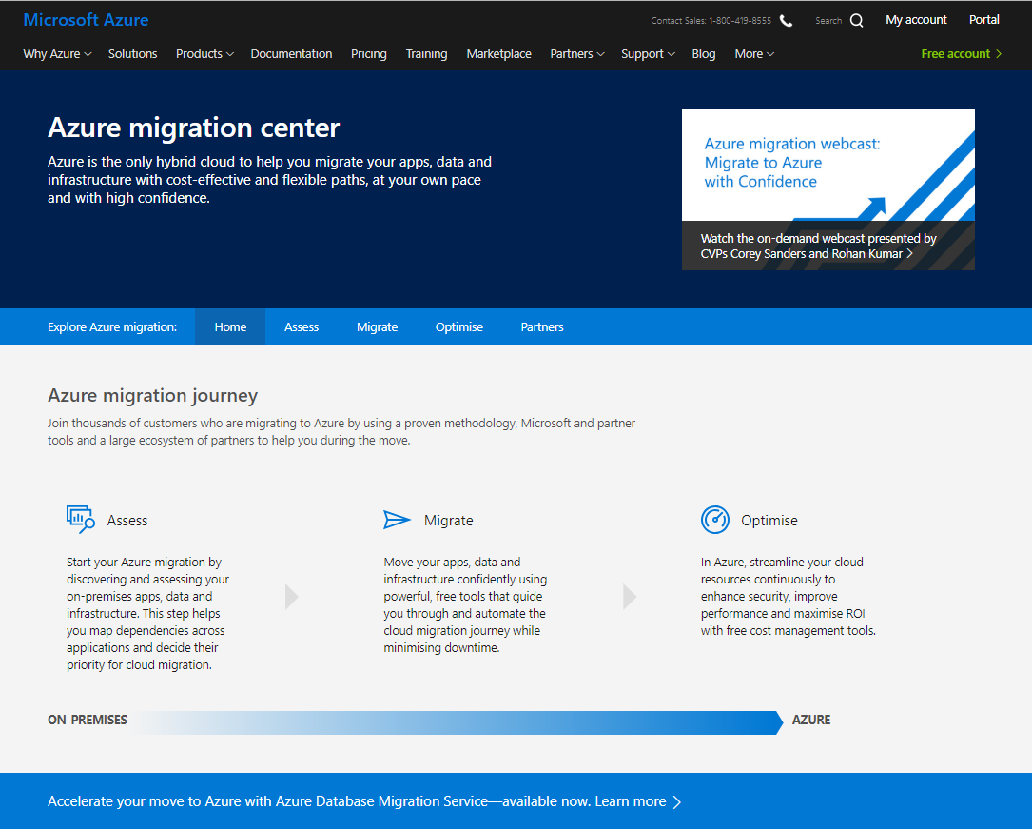
Azure Migration Center
 | Create Demand | Assess | Migrate | Optimize
Tools/ Products
Readiness and Content
Offers/ Incentives
How-to, case study and other related content across the apps & infra Migration journey
What is the Azure Migration Center
  A hub for Microsoft information regarding Azure migration
  Includes step by step guides to each stage of the migration journey, links to training, how-to, and case studies, as well as information on migration tools and ISV partners
When to use it
  The site is a reference across the entire migration practice journey, from planning initial investments to first PoCs to full customer migrations
  Watch Azure migration webinar series
How to access
  The site is a core part of the overall Azure.com site- and can be accessed directly here
  See Microsoft leadership discussing why now is the time to migrate to Azure in this video (requires registration)

Slide 35
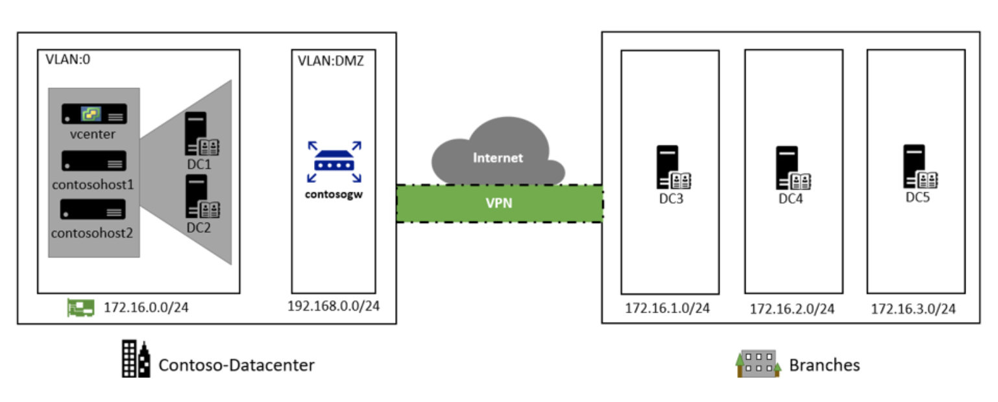
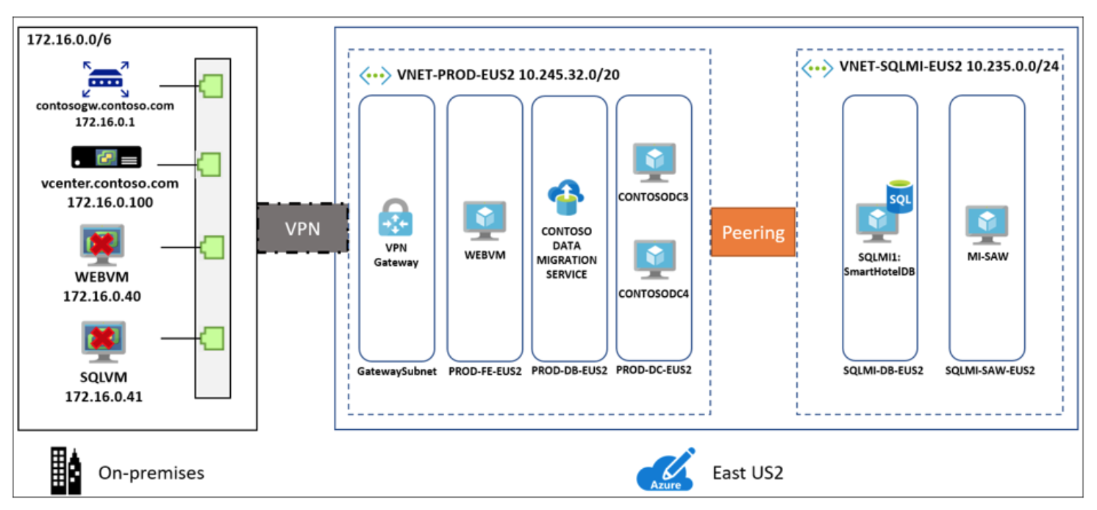
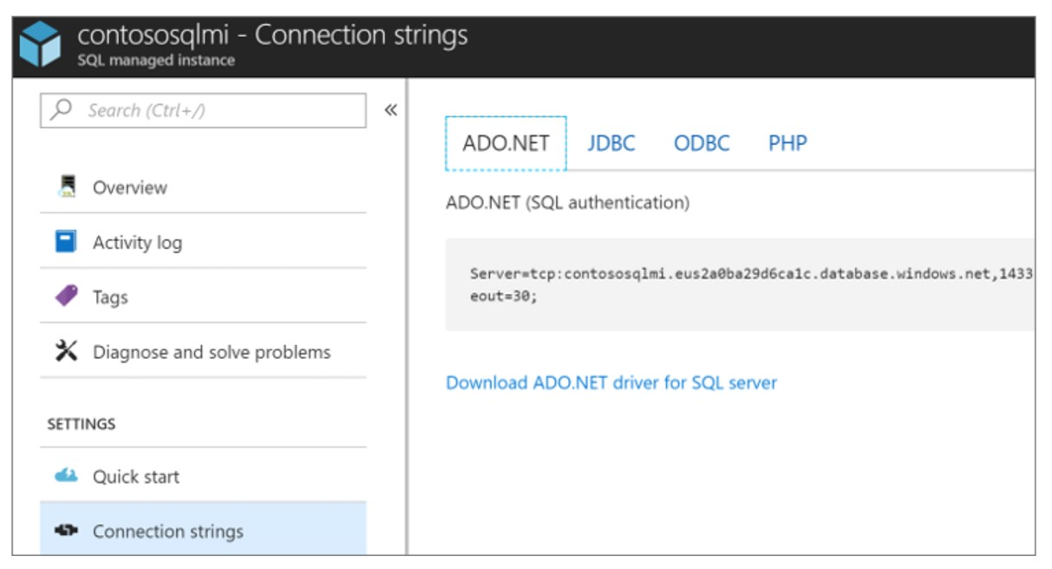
Migration How-Tos
 | Create Demand | Assess | Migrate | Optimize
Tools/ Products
Readiness and Content
Offers/ Incentives
Guide for migrating on-prem apps and databases to Azure
What is it
  Collection of step by step migration how tos
  The series provides example deployments that to understand and try out different options for migration to Azure, and for working in a hybrid environment
When and why to use it
  This resource extends beyond assessment into how tos for a number of different scenarios
How to access
  Data Platform Modernization
  Azure Migrate Documentation
  Rehost an app on Azure VMs and Azure SQL Managed Instance
  Rehost an app on Azure VMs
  Rehost an app on Azure VMs and Azure SQL AlwaysOn
  Rehost a Linux app on Azure VMs
  Rehost a Linux app on Azure VMs and Azure MySQL

Slide 36
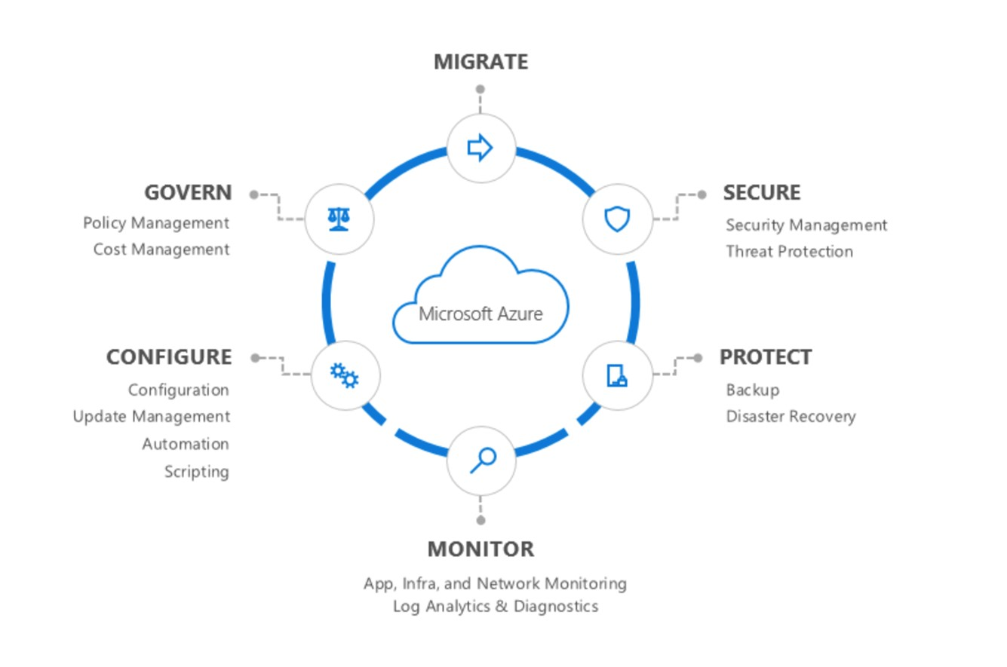
Secure and well managed IaaS
 | Create Demand | Assess | Migrate | Optimize
Tools/ Products
Readiness and Content
Offers/ Incentives
Customer deck focused on Azure in operation
What is it
  A customer deck including overviews of Azure security and management offerings and case studies
When to use it
  This is effective during the sales process for migration as back up, but mostly focused on the post migration ongoing service delivery phase
  Leverage as part of the “what happens next” discussion
How to access
  Azure Secure well-managed pitch deck
  Product page
Gain better visibility and control
Apply advanced threat protection
Drive continuous and agile management approach

Slide 37
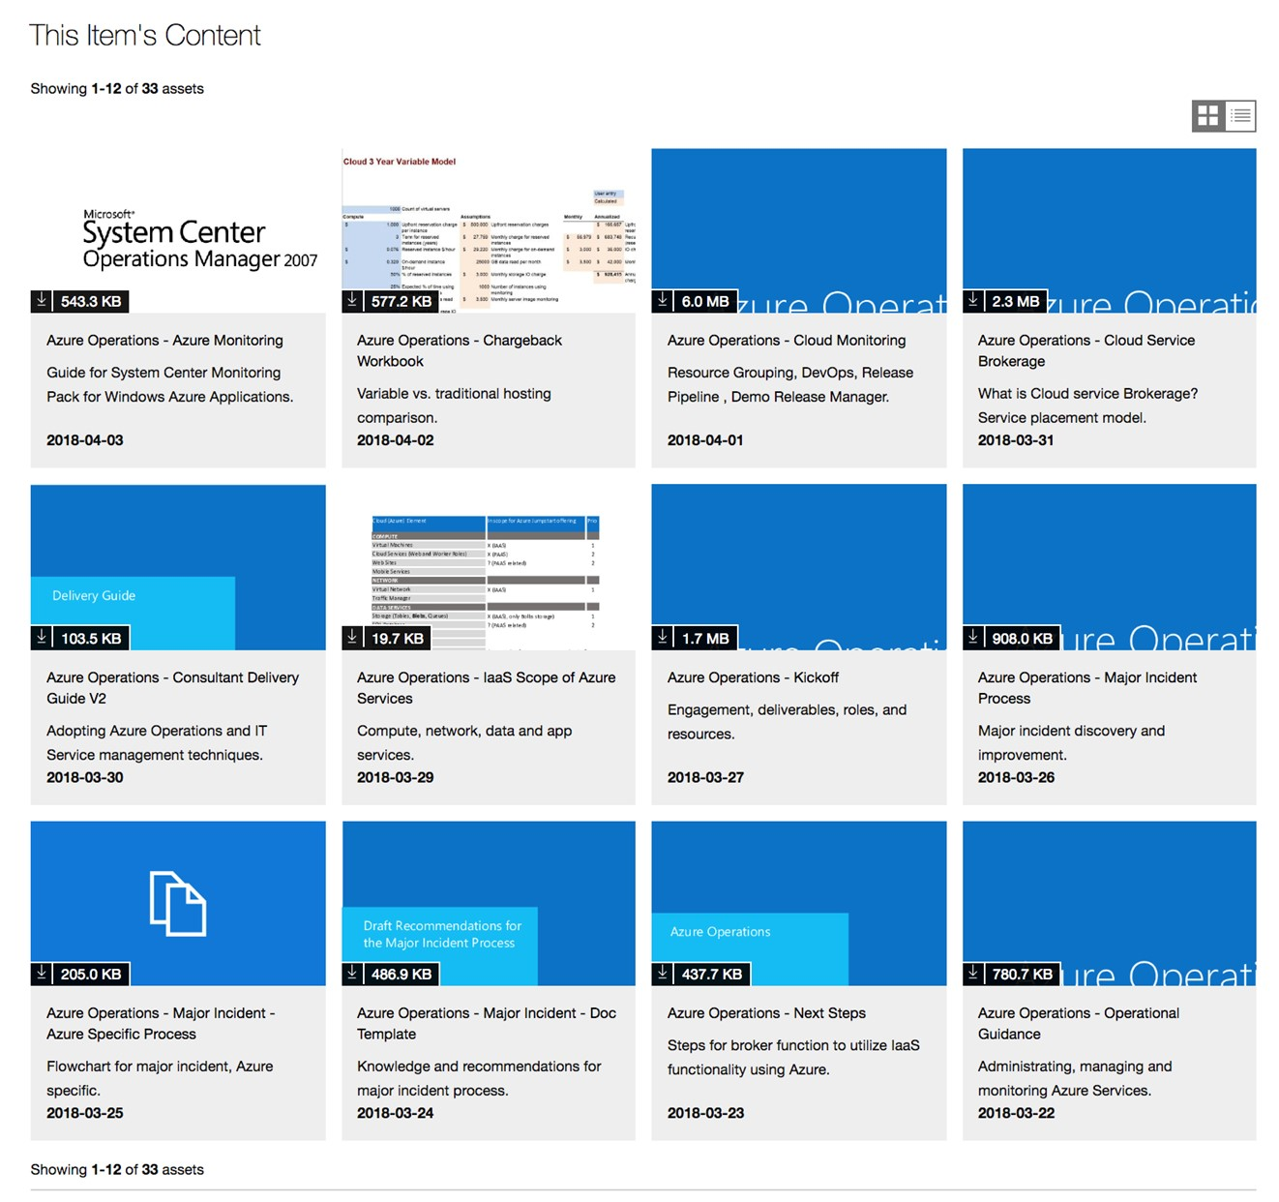
Azure Operations Jumpstart
 | Create Demand | Assess | Migrate | Optimize
Tools/ Products
Readiness and Content
Offers/ Incentives
Azure operations guides, explanations, templates etc.
What it is
  This is a collection of partner facing assets for post migration Azure operations, it includes guides, roles/RACI templates, and how to guides
When to use it
  The collection is useful even before migration to set up ongoing customer activities during the operations phase
How to access
  Jumpstart collection

Slide 38


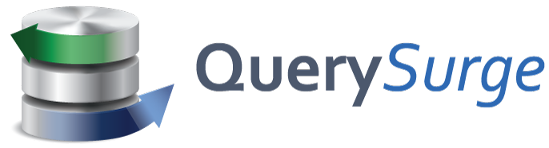



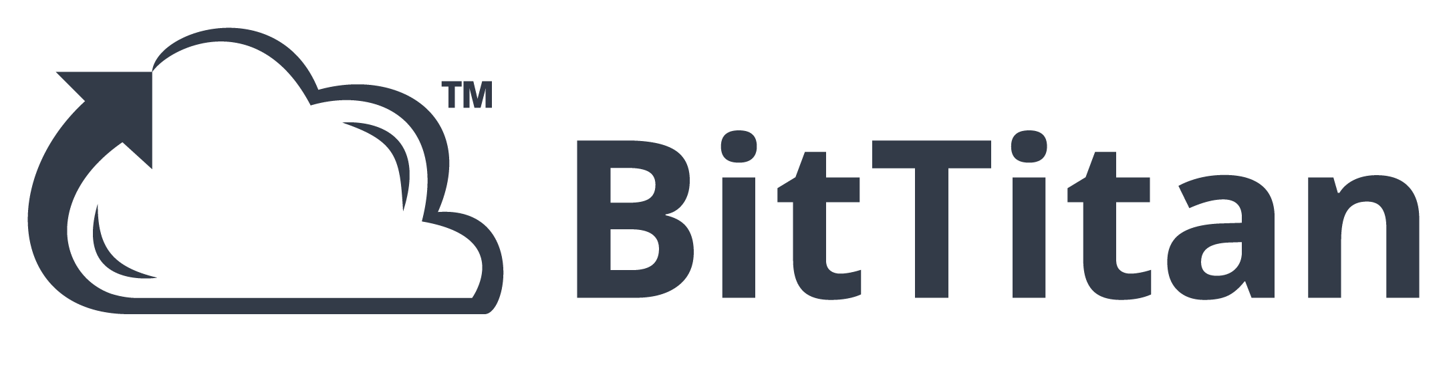


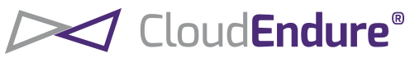






3rd Party Tools – more choices
 | Create Demand | Assess | Migrate | Optimize
Tools/ Products
Readiness and Content
Offers/ Incentives
Choice of ISV tools to meet every customer requirement
What is it
  ISV tools currently in market that are helpful for partners in driving assessments and migrations
How to access
  Learn more on Azure Migration Center

Slide 39
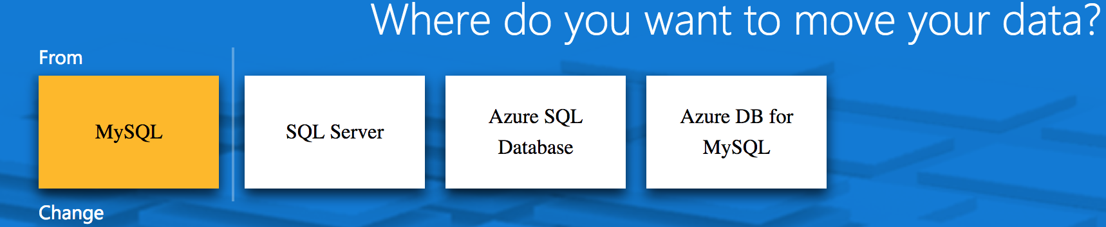
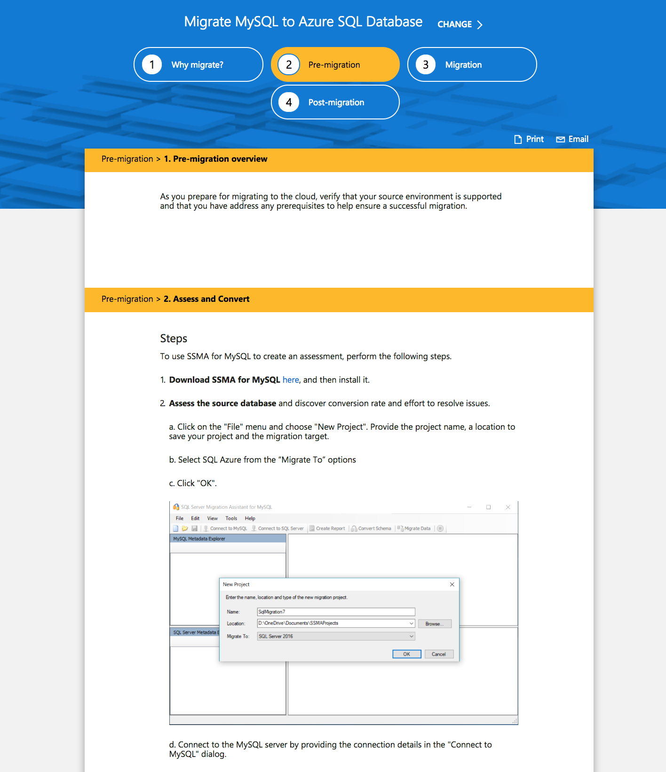
Azure Database Migration guide
 | Create Demand | Assess | Migrate | Optimize
Tools/ Products
Readiness and Content
Offers/ Incentives
List of tools, case studies and scenario configurator
What is the guide
  Guidance for partners from first customer interaction through migration planning and execution. Designed to be a customer guide for partners to reference, and share as appropriate.
  Includes:
    Scenario configurator
    First and third party tools, including links to ISV partner information
    Shareable customer case studies
When to use it
  Use the guide from first customer contact to PoC and migration planning
  The configurator creates a scenario based guides, including customer value statements and migration walk throughs. It supports migrating multiple common customer database configurations (including SQL Server, MySQL) to both Azure SQL and Azure DB for MySQL
How to access
  The guide can be accessed here

Slide 40
TCO and Cost Management
SMB Migration Partners in Western Europe

Slide 41
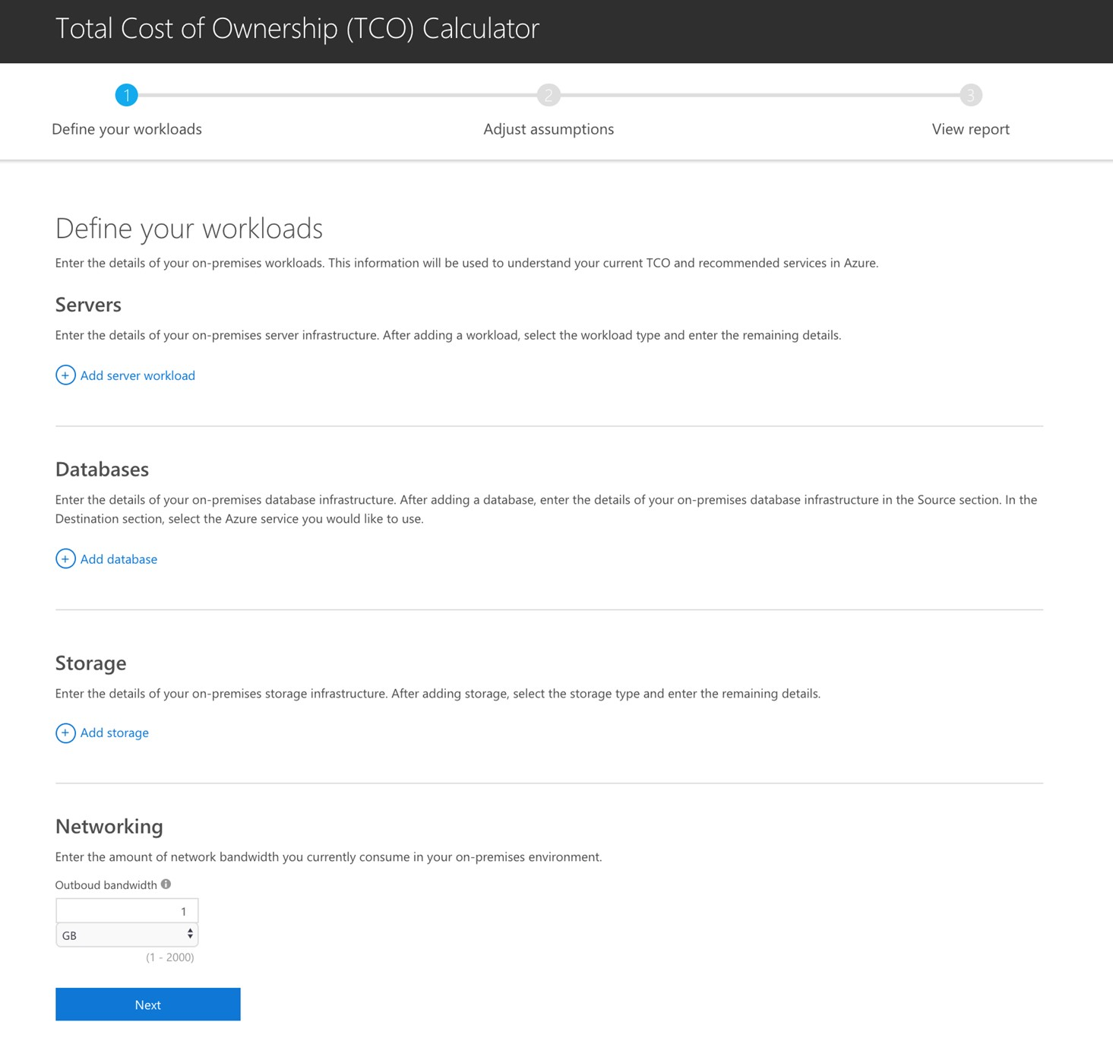
TCO calculator
 | Create Demand | Assess | Migrate | Optimize
Tools/ Products
Readiness and Content
Offers/ Incentives
Estimate cost savings by migrating workloads to Azure
What does the tool do
  The TCO Calculator recommends a set of equivalent services in Azure that will support customer workloads. The reporting shows each cost category with estimated on-premises versus Azure spend. There are several cost categories that either decrease or go away completely when customers move workloads to the cloud
Why to use it
  Cost savings are a strong part of the Azure value proposition- this simple tools lets partners visualize those for their customers
  This is a business development tool – it is an estimator of potential saving, not a quote tool
  Follow a simple three step process allows to demonstrate Azure cost savings to customers
How to access
  Link to TCO tool

Slide 42
Azure Cost Management Service
 | Create Demand | Assess | Migrate | Optimize
Tools/ Products
Readiness and Content
Offers/ Incentives
Analyze and recommend cost optimization actions
What is it
  A SaaS solution that empowers organizations to monitor, allocate, and optimize cloud spend in a multi-cloud environment.
  With Azure Cost Management, Microsoft is committed to continuing the investment in supporting a multi-cloud environment including Azure, AWS and Google Cloud Platform.
  This solution was previously known as Cloudyn
When to use it
  This is a key part of optimizing Azure deployments
  Partners should use the solution to gain full visibility and control over cloud spend, optimize cloud efficiency, and maximize the potential of the cloud.
How to access
  The solution is described here, and can be accessed at Cloudyn’s web site
  ACM is available to all partners and customers, as discussed here
  The base solution is free, with premium features being introduced in FY19 and a 1% charge to manage non-Azure cloud spend (details)

Slide 43
Placeholder Cloud operating model

Slide 44
Apps & Infra Migration Tools
SMB Migration Partners in Western Europe

Slide 45
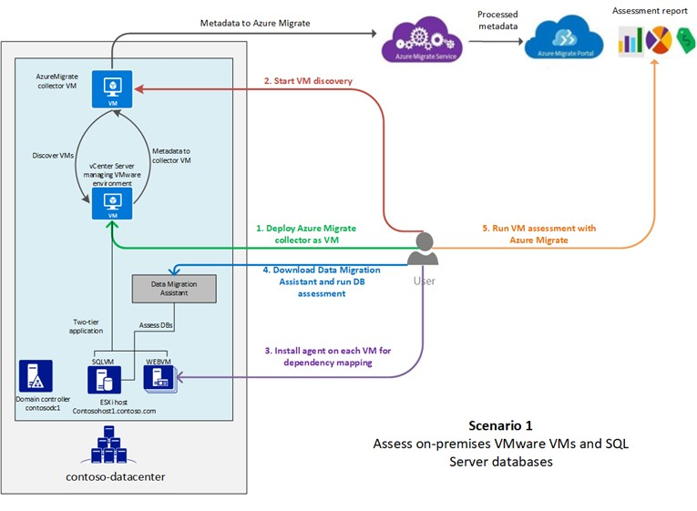
Azure Migrate
 | Create Demand | Assess | Migrate | Optimize
Tools/ Products
Readiness and Content
Offers/ Incentives
Assesses suitability of migrating on-prem VMs to Azure
What the service does
  Helps assess on-premises machines for migration to Azure, by assessing the migration suitability of the machines, and provides sizing and cost estimations for running in Azure
  Video demonstration
When to use it
  Azure Migrate is best used early in migration projects to understand migration complexity and costs going forward on Azure
  Currently, the Azure Migrate service can assess on-premises VMware VMs for migration to Azure
How to access
  Detailed information on the tool
  Try using the tool (requires Azure account)
  How to guide
  There is no charge to use Azure Migrate

Slide 46
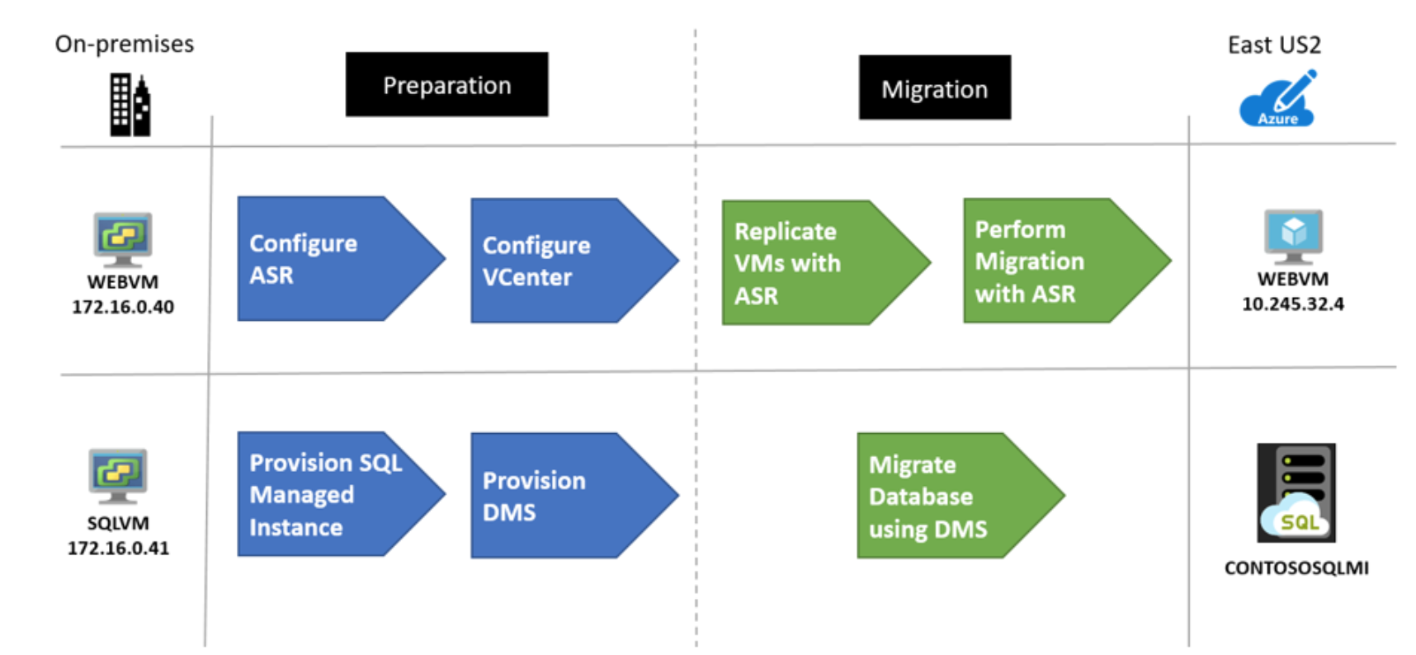
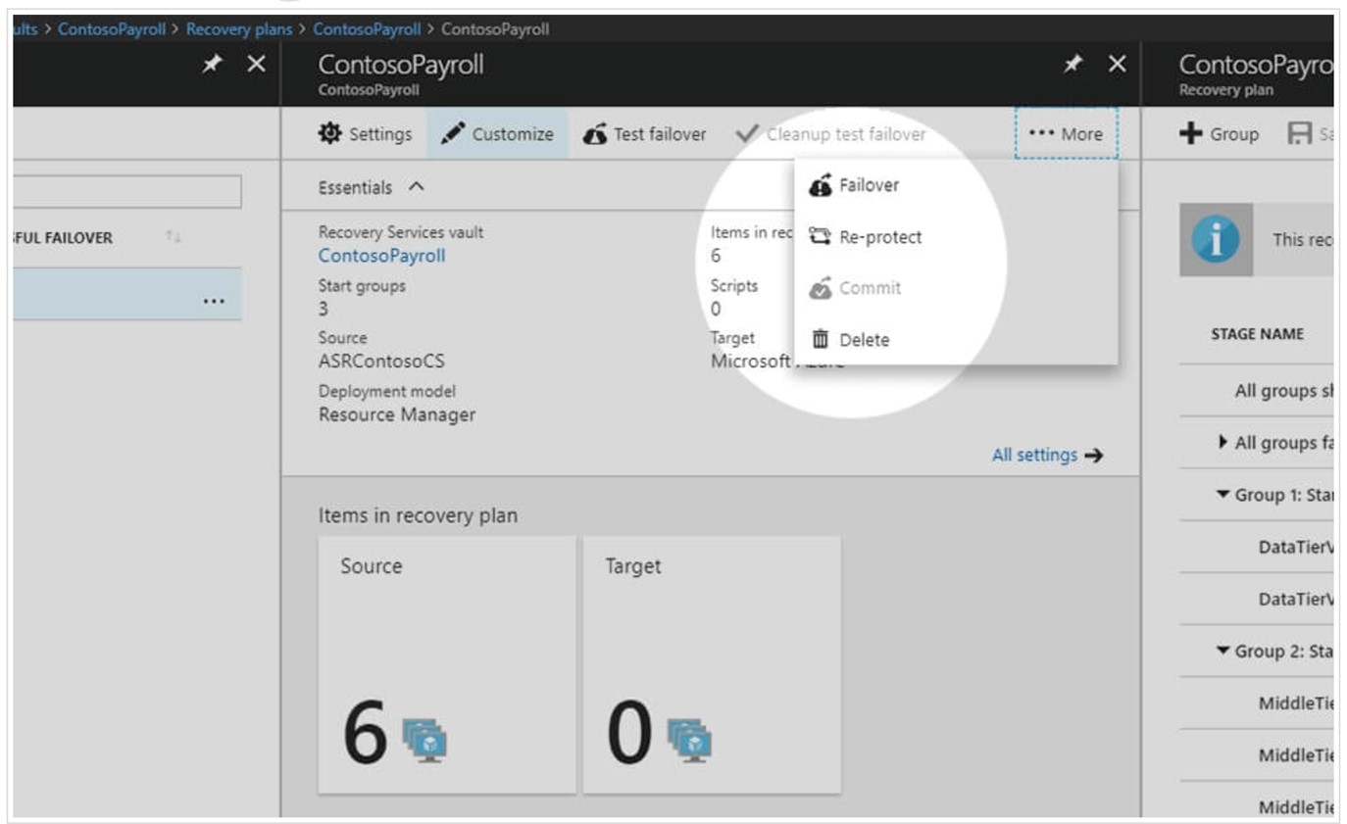
Azure Site Recovery
 | Create Demand | Assess | Migrate | Optimize
Tools/ Products
Readiness and Content
Offers/ Incentives
Tool supporting certain on-premises server, VM, and AWS [lift and shift] migrations to Azure
What is it
  ASR provides migrations of VMs and Apps to Azure across platforms VMWare, Hyper-V, Physical and Operating systems Windows and Linux.
  ASR provides zero data loss migration with near zero down time.
When to use it
  For simple VM lift-and-shift to Azure
    Zero application data loss during migration
    Near-zero application downtime during migration
    No-impact application testing in Azure
How to access
  Pricing: free for migrations
  Core tool guidance
  Walk though of re-hosting an on-premises app to Azure VMs and Azure SQL Managed Instance

Slide 47

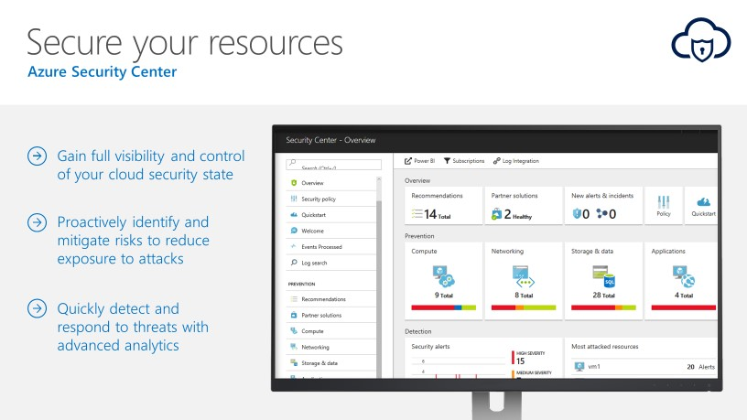
Azure Security Center
 | Create Demand | Assess | Migrate | Optimize
Tools/ Products
Readiness and Content
Offers/ Incentives
Secure resources by having full visibility with active risk migration and prevention tools
What is it
  Unified security management and advanced threat protection platform across hybrid cloud workloads. With Security Center, apply security policies across multiple workloads, limit exposure to threats, and detect and respond to attacks
When to use it
  Azure Security Center has robust capabilities to prevent attacks. When threats do happen, Security Center can quickly detect and respond to threats with advanced analytics and Microsoft Intelligent Security Graph
  To gain full visibility and control of customers’ cloud security state with a single, unified view
  To identify and mitigate risks proactively to reduce exposure to security threats
How to access
  The solution is described here
  The ASC has no upfront cost or termination fees, and is priced based on consumption (details)

Slide 48
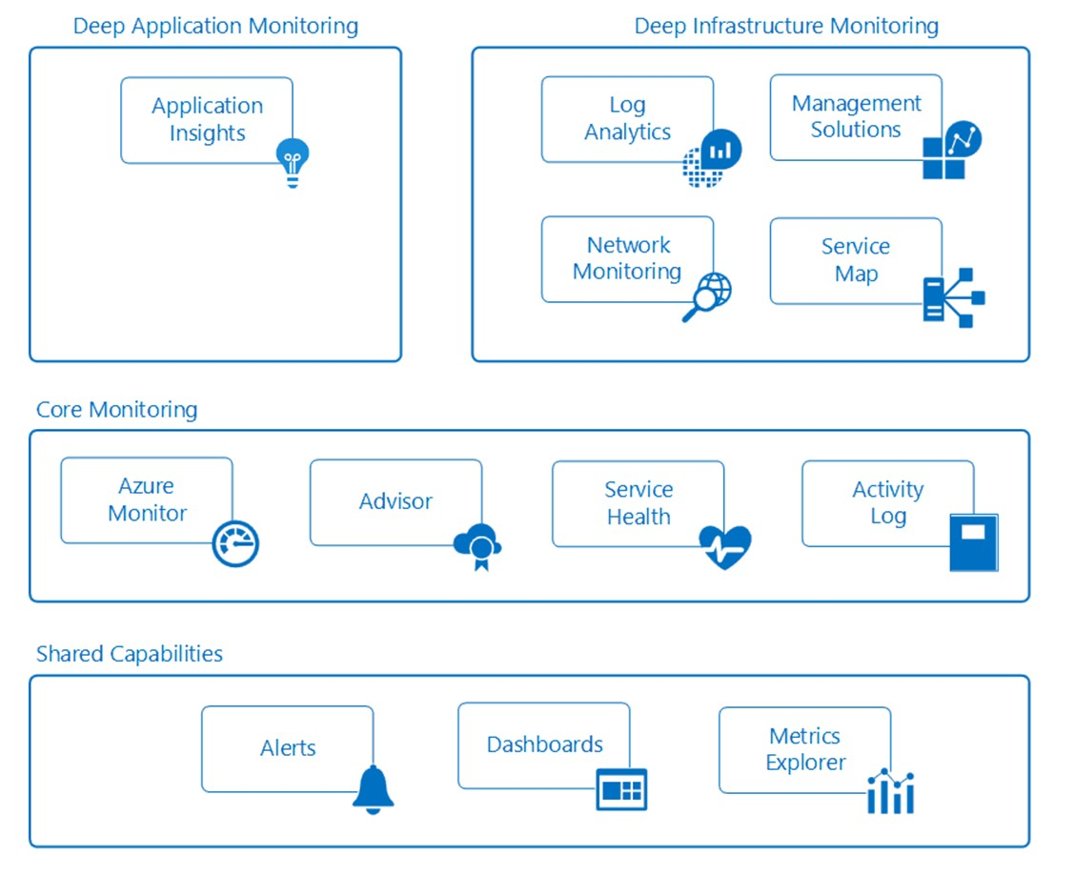
Azure Monitoring
 | Create Demand | Assess | Migrate | Optimize
Tools/ Products
Readiness and Content
Offers/ Incentives
Includes Azure Monitor and Azure Log Analytics to view, manage, and analyze Azure data
What is it
  Software solutions and visualization tools to centralize monitoring data from multiple systems in a single data store and derive insights.
When to use it
  Monitoring is tiered from shared capabilities, through to core and then deeper monitoring
  Transform Azure activity data and managed resources data across different subscriptions into actionable insights. Get deeper visibility into your hybrid IT environment including Azure and on-premises resources
  Detect, diagnose and fix issues quickly
How to access
  Scenario guidance is available here
  Azure Monitor is described here and Azure Log Analytics is described here
  Log Analytics is billed per gigabyte (GB) of data ingested into the service(details)

Slide 49
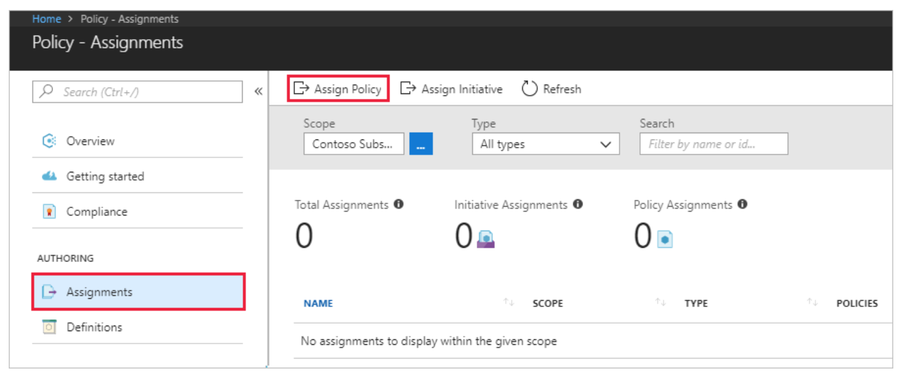
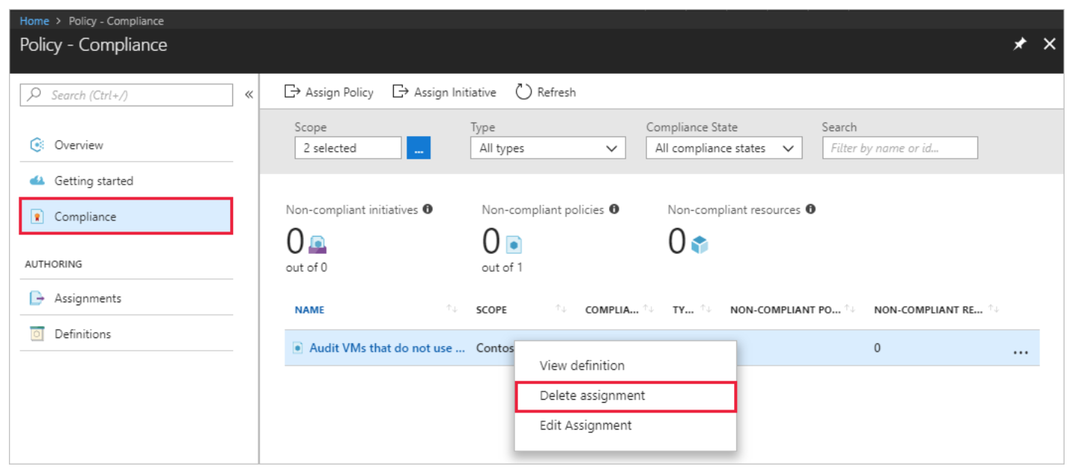
Azure Policy
 | Create Demand | Assess | Migrate | Optimize
Tools/ Products
Readiness and Content
Offers/ Incentives
Active control and governance at scale for your Azure resources
What is it
  Software solution and platform to control and govern at scale Azure resources, apply management, enforce policies and audit compliance
When to use it
  To add policies to resources easily, restrict deployment options for organization to specific datacenters, or enable the creation of specific resources types only. Establish tagging metadata to help drive accountability and compliance
  To apply policy and enforce compliance at scale easily
How to access
  Azure Policy is described here
  There are no charges for using Azure Policy (details)

Slide 50
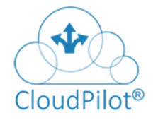

3rd Party App Modernization Migration Tools
 | Create Demand | Assess | Migrate | Optimize
Tools/ Products
Readiness and Content
Offers/ Incentives
Application-centric tools focused on migration and optimization
Workflow stage
Infrastructure Assessment (Discover & Plan) | No | No
Detailed Application Assessment (Discover & Plan for Apps) | Yes - Static Code analysis of Apps, Databases and Config files (including Open Source) to identify code quality (higher-level summary; not line item specifications) | Yes - Static Code analysis of Apps, Databases and Config files to identify all changes needed to run in Azure
Migrate | No | Yes (Requires ASR for VM Migration, ACS & AKS for Container migration, or other 3rd party offerings)
Optimize | Yes (based on Code quality) | Yes
Introduction/Demo | Intro video Demo video | Intro video

Slide 51
Database Migration Tools
SMB Migration Partners in Western Europe

Slide 52
Azure Database Migration guide
 | Create Demand | Assess | Migrate | Optimize
Tools/ Products
Readiness and Content
Offers/ Incentives
List of tools, case studies and scenario configurator
What is the guide
  Guidance for partners from first customer interaction through migration planning and execution. Designed to be a customer guide for partners to reference, and share as appropriate.
  Includes:
    Scenario configurator
    First and third party tools, including links to ISV partner information
    Shareable customer case studies
When to use it
  Use the guide from first customer contact to PoC and migration planning
  The configurator creates a scenario based guides, including customer value statements and migration walk throughs. It supports migrating multiple common customer database configurations (including SQL Server, MySQL) to both Azure SQL and Azure DB for MySQL
How to access
  The guide can be accessed here

Slide 53
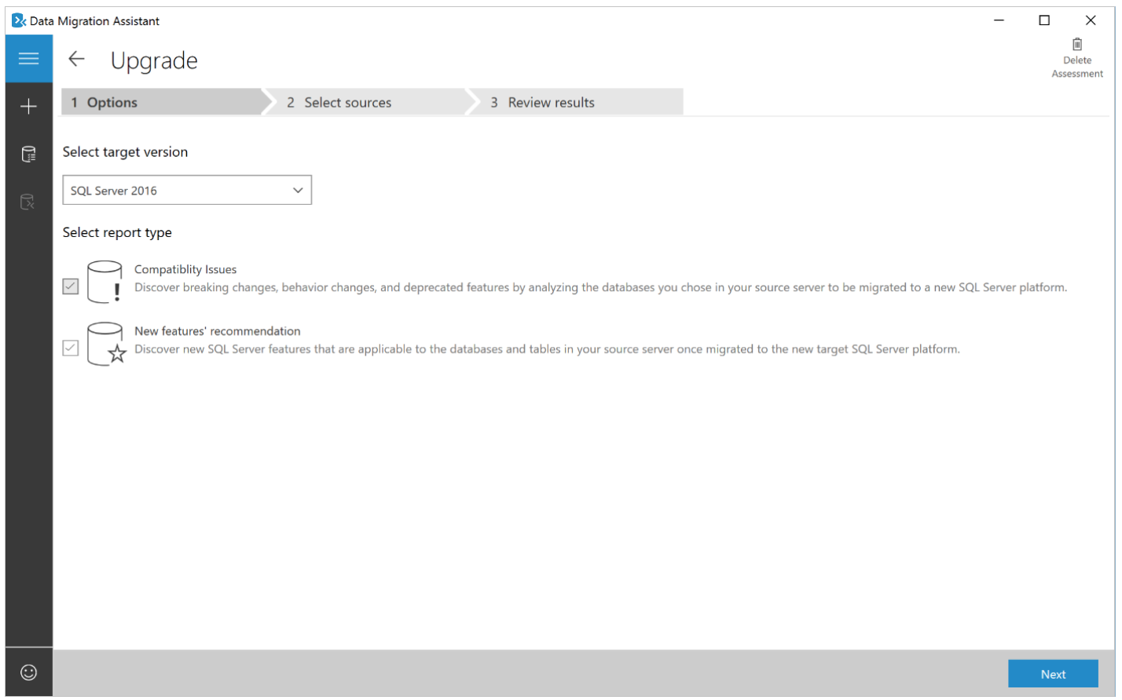
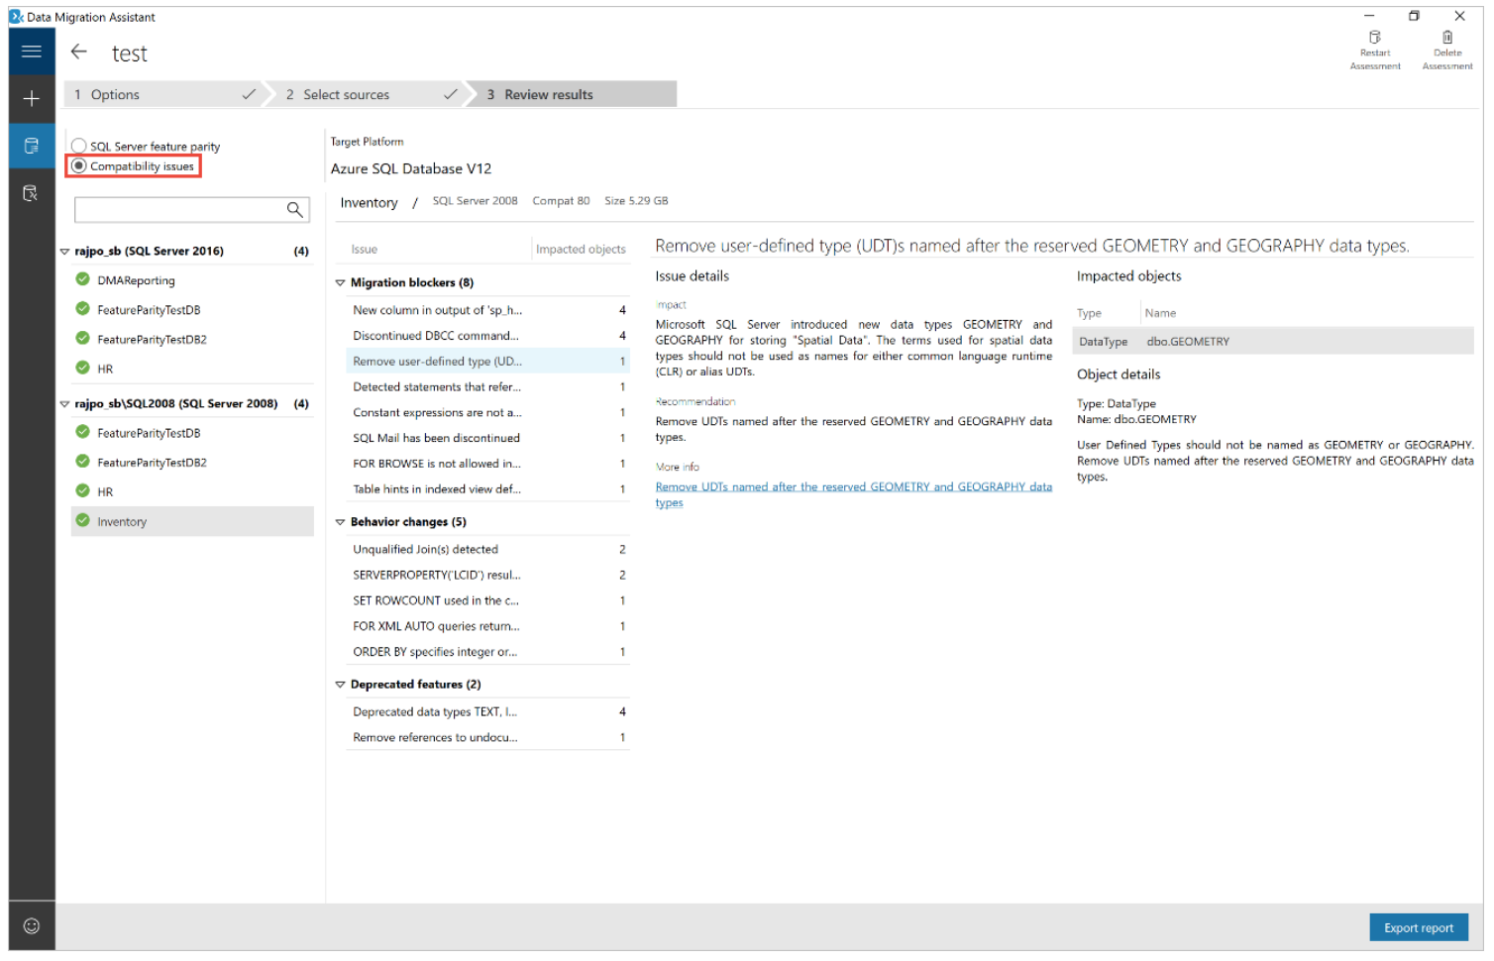
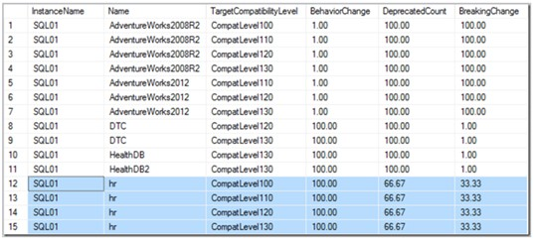
Azure Database Migration Assistant
 | Create Demand | Assess | Migrate | Optimize
Tools/ Products
Readiness and Content
Offers/ Incentives
Detecting compatibility issues impacting migration to Azure SQL Database
What is the tool
  The Data Migration Assistant enables customers to upgrade to a modern data platform by analyzing and detecting compatibility issues that can impact database functionality on a new version of SQL Server.
  It recommends performance and reliability improvements for target environments. It enables moving of schema and data, as well as uncontained objects from source server to target server.
When to use it
  The Assistant is optimized for SQL Server to Azure SQL migrations
  For large (in terms of number and size of databases) migrations, it is recommended to use the Azure Database Migration Service, which can migrate databases at scale
How to access
  Tool overview and how to guide
  The tool can be downloaded here

Slide 54







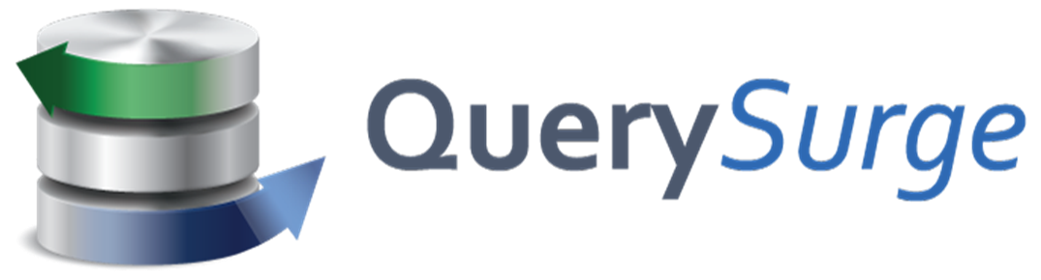


Azure Database Migration – 3rd Party Tools
 | Create Demand | Assess | Migrate | Optimize
Tools/ Products
Readiness and Content
Offers/ Incentives
Listing of approved data migration tools
What is it
  Third party tools can be can be an important part of a data migration, depending on customer situation and preference
  This list is the set of third party tools that Microsoft recommends
When to use it
  Use this checklist to find the right tools for customer data migration
How to access
  The list is a core part of the Data Migration Guide
 | Attunity Replicate Empowers organizations to accelerate data replication across a wide range of heterogeneous databases.
 | Striim Real-time platform enables companies the power of in-memory streaming data integration and intelligence into Azure.
 | Ispirer Offers migration tools and services for Microsoft SQL Server and others.
 | Datometry Hyper-Q: simplifies how enterprises manage existing, and develop new applications on cloud databases.
 | Morphis Transformer: helps with transforming an application into a new language; or modernize into a multi-tier architecture.
 | Corent : Corent's SurPaaS® is a fully integrated platform to automatically Analyze, Cloudify, and SaaSify - any software application, without any programming.
 | Informatica: Empowers data-driven digital transformation with ETL/ELT, data integration, management, quality and big data solutions for Azure.
 | QuerySurge: Automates the task of validating data movement from an on-premises data warehouse installation to an Azure Cloud installation.
 | Movere: Automates inventory, collection, analysis, and visualization of data, providing answers to usage and infrastructure questions with extraordinary precision.
 | Cloudamize: Cloud analytics platform offers precision analytics and powerful automation to improve the speed and accuracy of moving to the cloud.

Slide 55
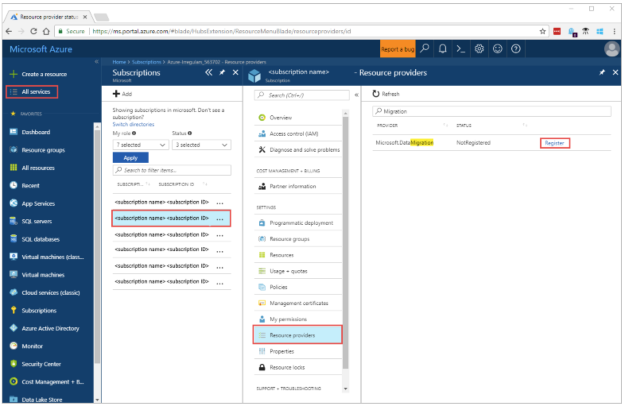
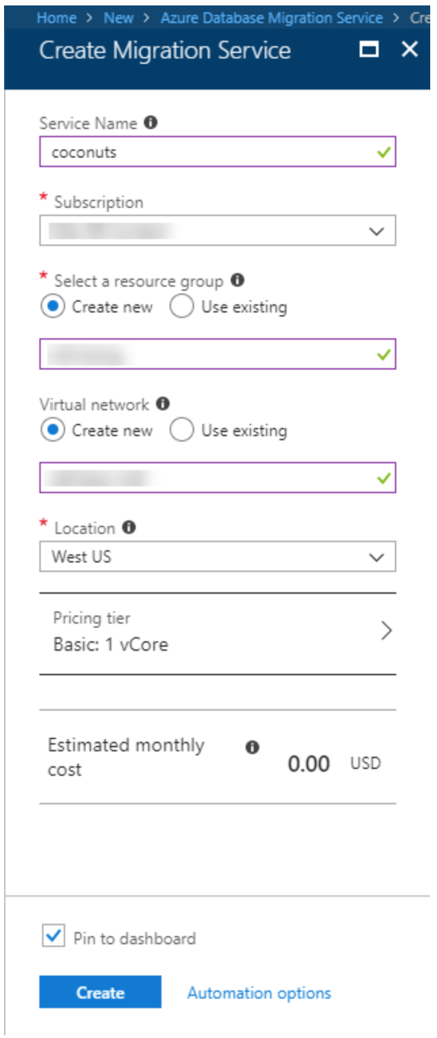
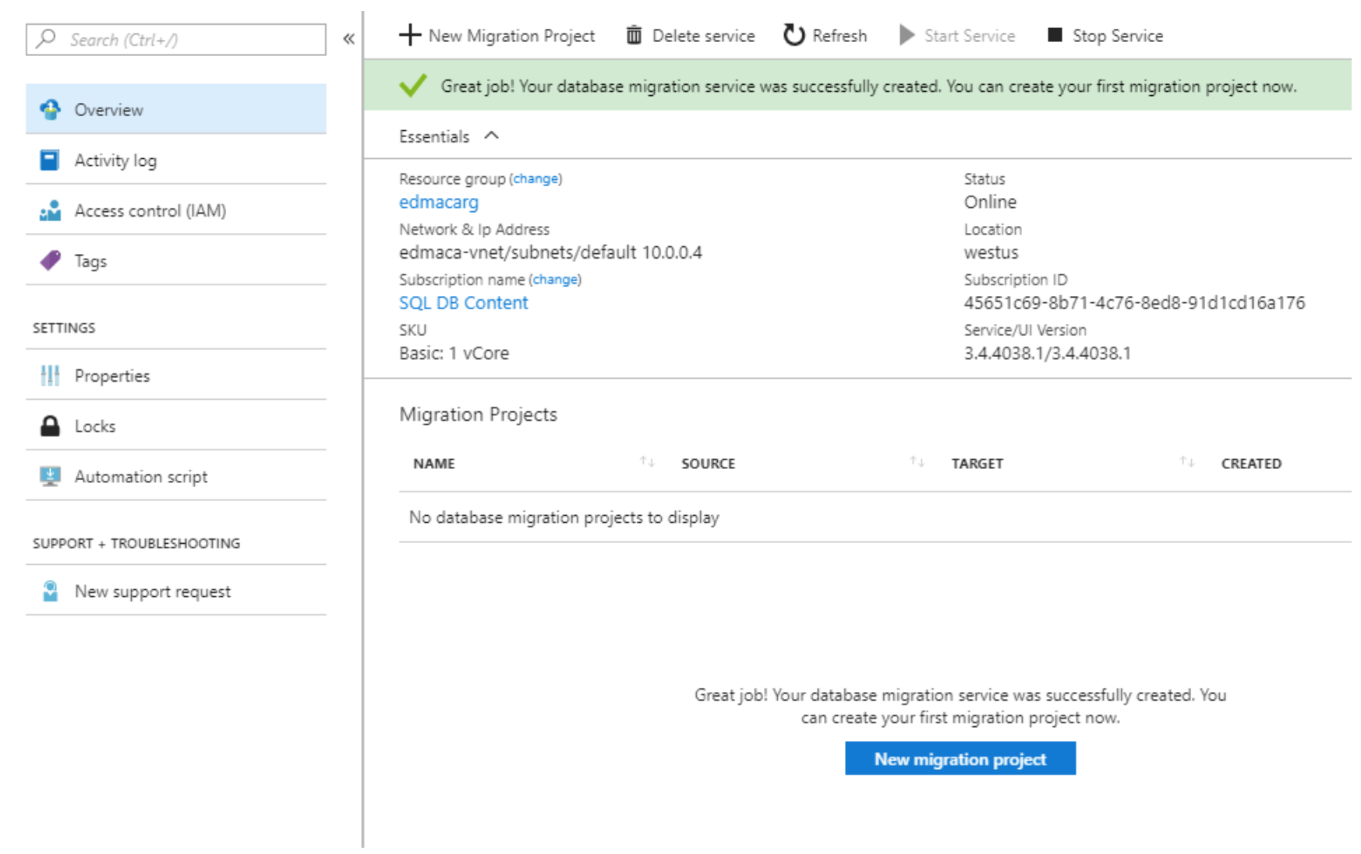
Azure Database Migration Service
 | Create Demand | Assess | Migrate | Optimize
Tools/ Products
Readiness and Content
Offers/ Incentives
Migrate a databases to Azure
What is it
  The Azure Database Migration Service is a fully managed service, available in most Azure regions, designed to enable seamless migrations from multiple database sources to Azure Data platforms with minimal downtime
Supported scenarios
  The service supports migrations from SQL Server to Azure SQL Database
  Go to the Azure portal now to start using the Azure Database Migration Service for this scenario
  Migration from SQL Server to Azure SQL Database Managed Instance is in public preview
How to access
  Full details on how to access the tool and walk throughs
  Regional availability

Slide 56
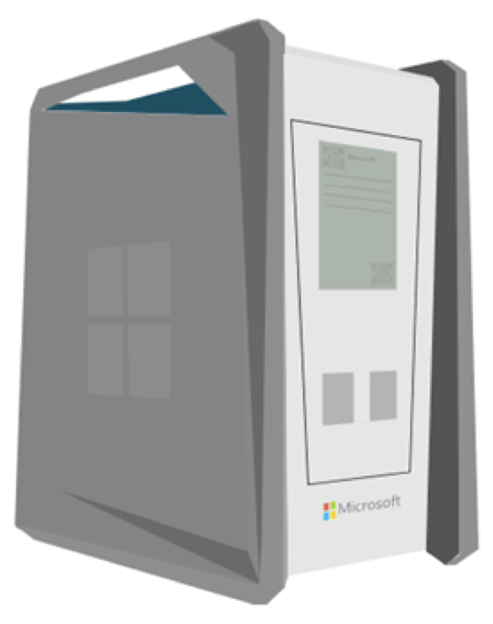
Azure Data Box (Preview)
 | Create Demand | Assess | Migrate | Optimize
Tools/ Products
Readiness and Content
Offers/ Incentives
Secure ruggedized appliance for data transfer
What is it
  The Azure Data Box service enables the transfer large amounts of data to Azure where network-based transfer is constrained by time, availability, or cost
  It is secure (256 bit-AES encryption) and easy to use (built in administration capabilities) to deliver a quick and simple method for transfer of customer data to Azure
When to use it
  The service is in preview today (June 2018)
  The Azure Data Box service is built to transfer large (terabytes) amounts of data to Azure
How to access it
  Request a Data Box today - Preview Sign Up
  (requires Azure account)
  Pricing (standard Azure storage rates apply after transfer)
  Additional service information
  Azure Storage Documentation
Azure Data Box ^{Preview}
Fast
Secure & Rugged
Easy to use
Partner Supported
Azure Data Box Service lets you move hundreds of terabytes of data into Azure with high speed using secure transfer appliances. We accelerate the movement of your data by shipping you a proprietary, secure, and tamper-resistant transfer appliance and handle the end-to-end logistics. Learn more

Slide 57
Partner Technical Support
SMB Migration Partners in Western Europe

Slide 58
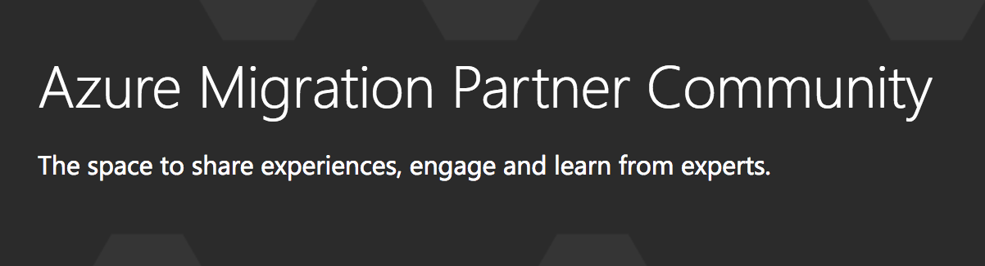
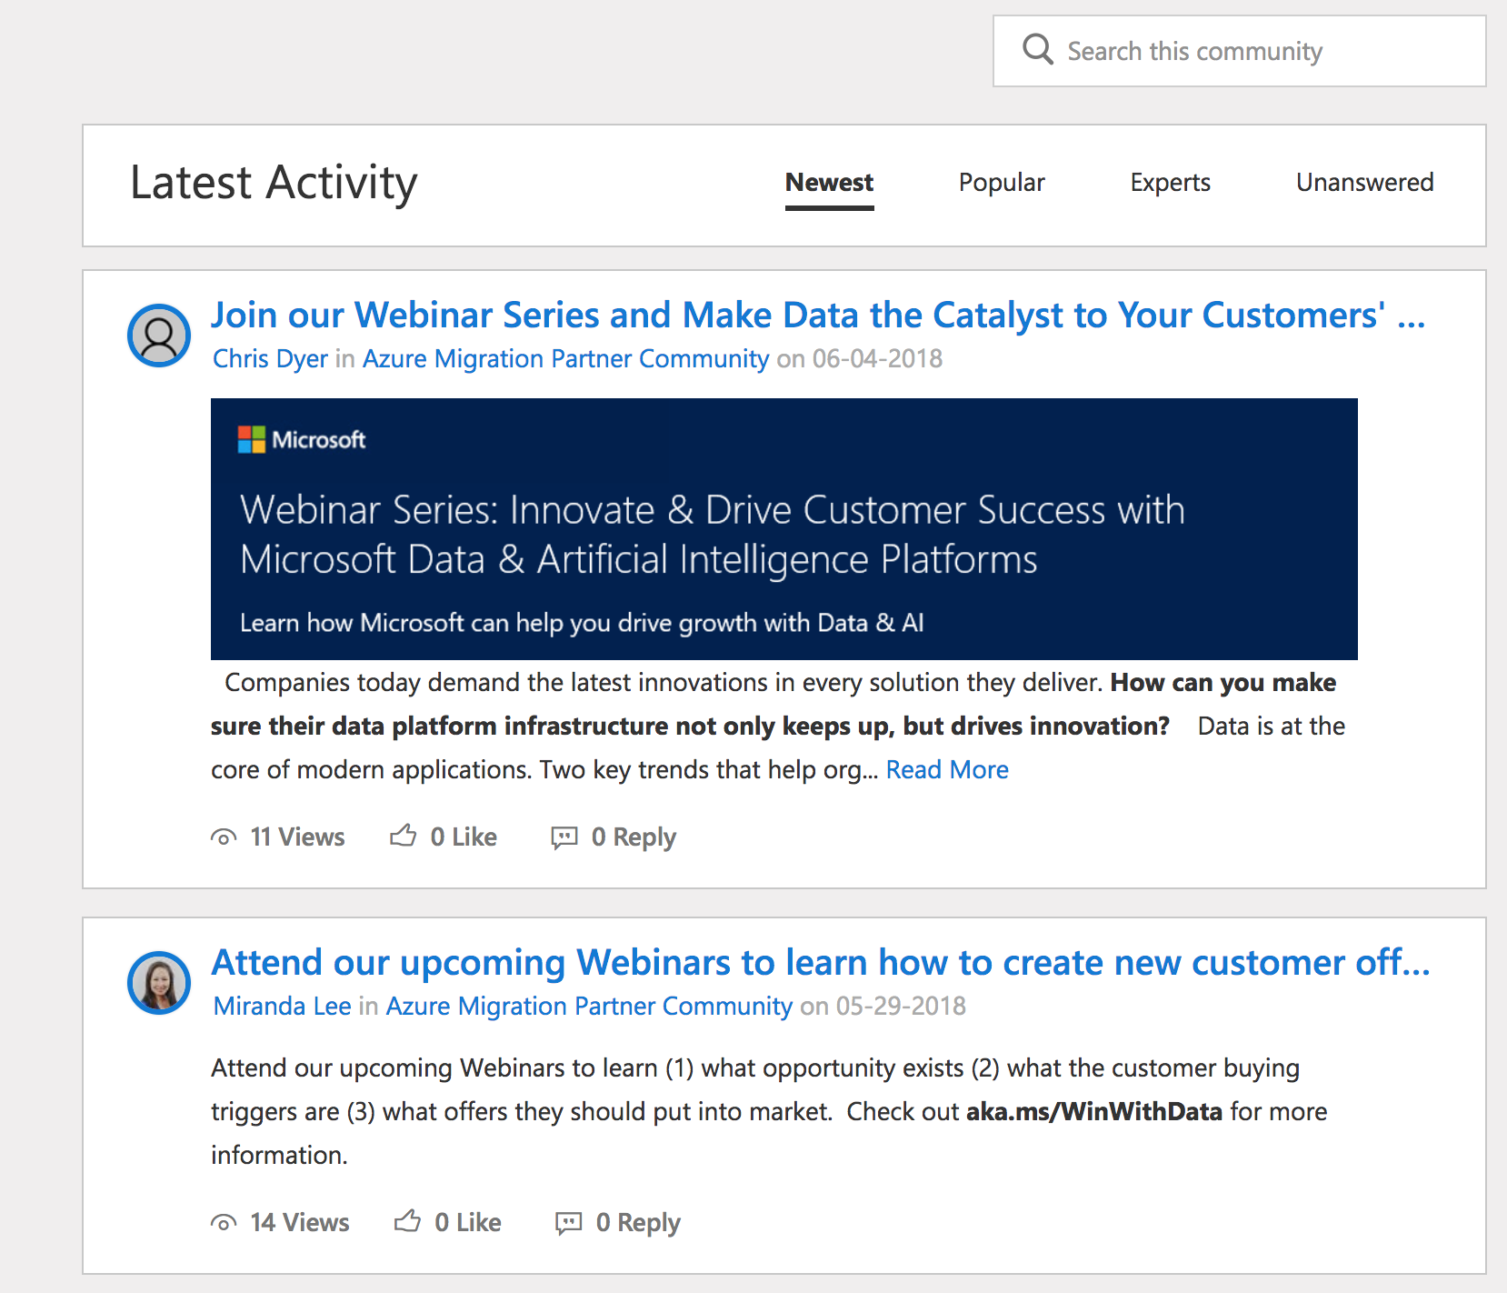
Community Support
 | Create Demand | Assess | Migrate | Optimize
Tools/ Products
Readiness and Content
Offers/ Incentives
Direct SME engagement through partner community
What is it
  The Azure Migration Partner Community is the best place for migration partners to interact with other partners and Microsoft engineers
  The right place to keep up to date with Azure migration and to access the latest migration updates, events, trainings and other resources
When to use it
  Recently launched- expected to be to the focus for migration specific content, and a place for partners to interact with peers and Microsoft experts
How to access
  The Azure Migration Partner Community requires simple registration with the Microsoft Tech Community (link to join).
Other relevant communities include:
  Microsoft Partner Community
  CSP Partners
  Azure Support Community
  Microsoft technical community

Slide 59
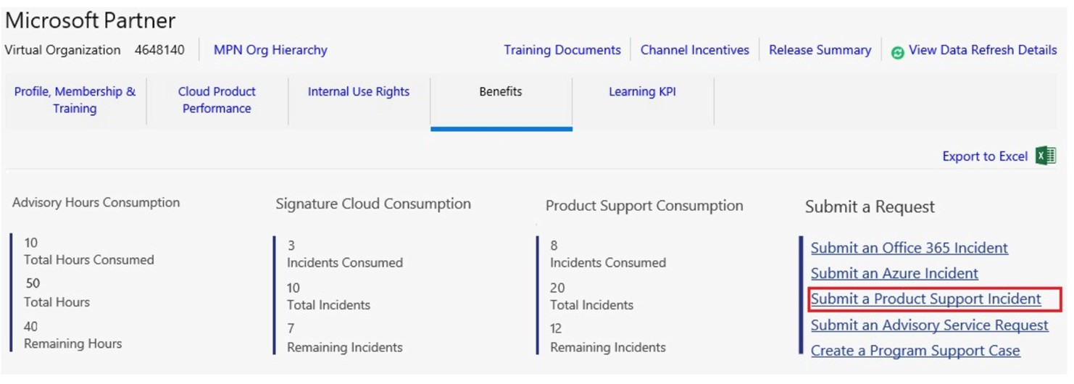

Partner Technical Support
 | Create Demand | Assess | Migrate | Optimize
Tools/ Products
Readiness and Content
Offers/ Incentives
Multiple technical support offers for different tiers of partners
What is it
  A strong set of technical support offers for different partner tiers
  Includes support tracking tools and ability to submit tickets on behalf of customers
When to use it
  Leverage this for tricky customer situations, potential bugs and other issues
How to access
  Technical Support for Microsoft partners
  Compare partner support plans
  Support options for Azure CSP partners

Slide 60
Free Technical Support
CSP
 | Create Demand | Assess | Migrate | Optimize
Tools/ Products
Readiness and Content
Offers/ Incentives
15 hours for tool, billing, API questions
What is it
  Support and training for tooling, APIs, billing, partner center, migration best practices
  Microsoft has partnered with Sysgain Inc, a SI company based in Redmond and India, that specializes in migration and CSP consulting services to Managed Service Providers, on how to approach and succeed in datacenter migration.
When to use it
  For Customer Datacenter Migration Program partners receive up to 15 hours of CSP technical support provided by Sysgain free of charge. The support include:
    Provide migration guidance and support on tools, techniques, processes, provide necessary documentation
    Provide Guidance on CSP & any integration help as needed
How to access
  To access the Sysgain offer send the list of e-mail addresses that will interact with CSP technical helpdesk to customermigsupport@sysgain.com

Slide 61



On-demand trainings and webinars
 | Create Demand | Assess | Migrate | Optimize
Tools/ Products
Readiness and Content
Offers/ Incentives
Training for migration scenarios, 1st and 3rd party tools, APIs, billing, partner center, best practices
What is it
  Training and other resources for each stage of the Azure journey, from videos to hands on labs
When to use it
  Training is available for scenarios, specific tools (typically in how to content), as well as more generally for Azure and cloud deployment
How to access
Data Estate Modernization Webinar Series
Hands on lab
Free online learning resources to develop your Azure skills
Get started with Azure (Microsoft Docs)
Azure Classes for IT Pros (Microsoft Academy)
Azure Certification
Develop key capabilities via Technical Journeys

Slide 62

Service Map
 | Create Demand | Assess | Migrate | Optimize
Tools/ Products
Readiness and Content
Offers/ Incentives
Automatically discover and map servers and their dependencies in real-time
What is Service Map
  A product that automatically discovers application components on Windows and Linux systems and maps the communication between services
  Enables viewing of servers as interconnected systems that deliver critical services
When to use it
  Service Map shows connections between servers, processes, and ports across any TCP-connected architecture, with no configuration required other than the installation of an agent
  Use Service Map to effectively plan, accelerate, and validate Azure migrations, which helps ensure that nothing is left behind and surprise outages do not occur
How to access
  Product page
  Using Service Map (including a specific section on how to use the tool in migration scenarios)

